Slide 1
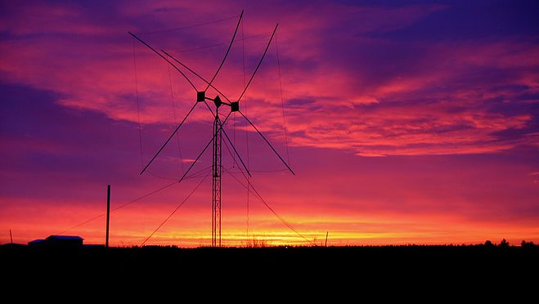
Spokane County 800 MHz Radios
An overview of procedures for ACS volunteers
Photo by Gordon Grove – WA7LNC

Slide 2
Agenda
Radios you may encounter
Operational Parameters
Never Push the RED Button!
Channelization
Basic Operation
CEMNET and EMD EOCs

Slide 3
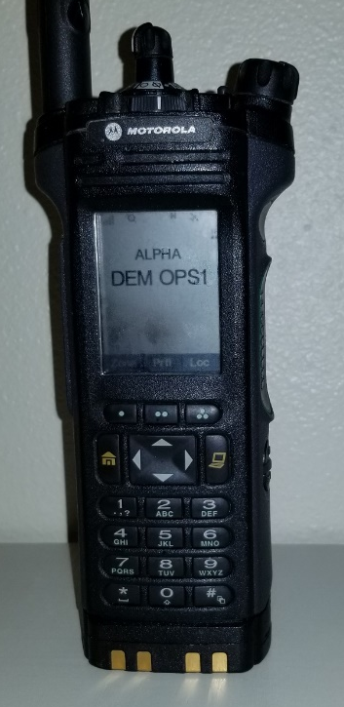
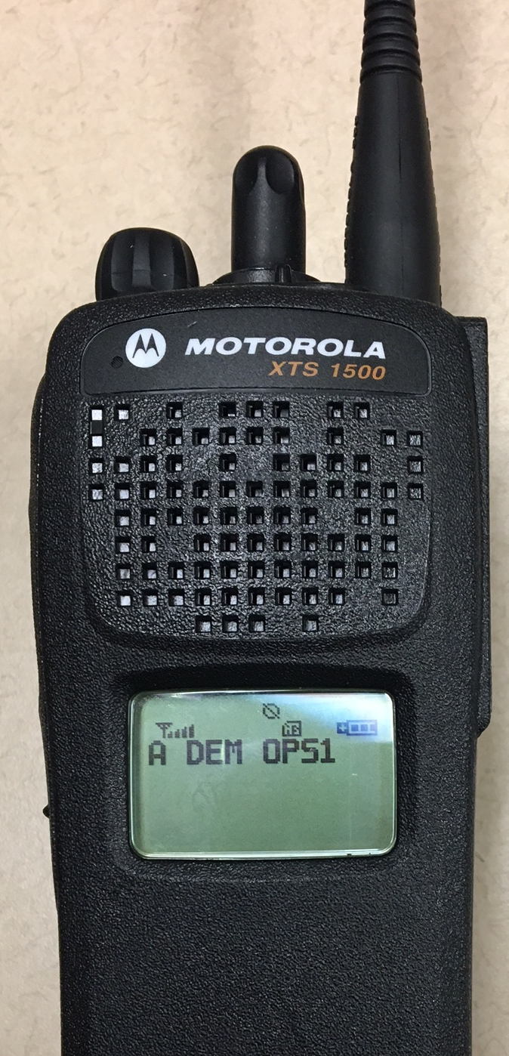
Radios You May Encounter
Spokane County uses a variety of Motorola radios:
  Handheld
  Mobile
  Base Station
These are photos of handheld models you may be asked to use as an ACS volunteer with the Spokane County Department of Emergency Management (DEM)

Slide 4
Operational Parameters
Operating Bands
  800 MHz
  Encrypted & Non-encrypted Channels
  Some have VHF channels for interoperability with other agencies or surrounding counties
Use of “Zones”
  16 channels in each Zone
  Use of Logical groupings for agencies such as Law Enforcement and Fire Services
  Ability to quickly switch between channels
As an ACS volunteer, you will need to know how to:
    Change Zones
    Change Channels
    Adjust Volume
    Never push the Red button

Slide 5

Never Push the RED Button!
Whether the radio is On or Off, pressing the RED Button sends out an emergency call to all other county radios
County law enforcement departments WILL respond
Don’t be “that guy”

Slide 6
Channelization
An ICS-217 will be supplied for each radio used
  Easier to locate channels
  DEM issued radios will have DEM’s channels listed first in the Alpha zone
DEM has two channels for its sole local use
  DEM Main - a non-encrypted channel for non-secure use
    All other County radios have access to it at Echo 16
  DEM Ops1 - an encrypted channel for more secure use
    Primarily utilized for incident response by our MEOC volunteers
    Only DEM, SRECS and dispatchers have access to this channel
DEM Ops2 is an encrypted channel
  This channel is for use by ACS for passing traffic

Slide 7
Basic Operation
Volunteers may be directed to use other channels at specific times in support of other agencies or for planned exercises
Never transmit on the other channels except:
  When authorized, or
  During an emergency
Operator Identification
  Use your County assigned ID number with phonetic
    Example: “This is Edward 1234
    You may also add “with DEM”
    You may also use your name as needed
  Tactical call signs may be used in lieu of your “Edward” number
    For use on DEM Channels ONLY
    During events and exercises

Slide 8
CEMNET and EMD EOCs
DEM has a unique channel on the 800 MHz system that connects to EMD at Camp Murray
  Un-encrypted voice communications between DEM’s and EMD’s EOCs
  This is listed as CEMNET on DEM 800 MHz radios
  DEM’s station callsign is KJI575 (Kilo Juliet India Five Seven Five)
  This uses a microwave backbone and has some vulnerabilities
HF radios in the Comm Room and Trailer are setup for the Federal SHARES system
  Capable of voice and Pactor 4 data communications
  This is a backup to the CEMNET system
  Encryption is available for both voice and data
  These radios can also be utilized for communications on the Amateur bands

Slide 9
Summary
The county uses zones and channels instead of frequency designators
ACS is normally limited to DEM channels, but operators may be directed to utilize other specific channels
Don’t push the RED Button
When operating County radios, you are representing both yourself and the County
Be aware, most other channels are monitored and may be recorded
Proper radio operation and radio discipline will lead to an appearance of professionalism

Slide 10

Questions

