Slide 1


Slide 2
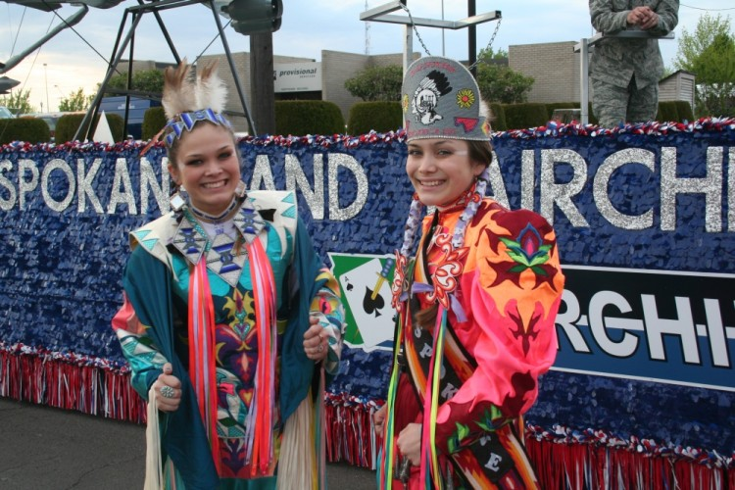
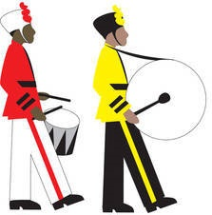
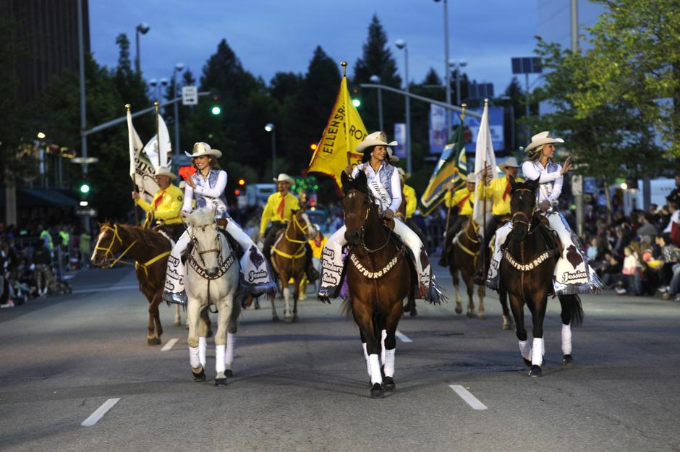

While the primary purpose of this parade is to honor our Armed Forces, it is also a showcase for our community, our schools and the culture of the Pacific Northwest.
Usually, the Lilac Parade happens on
The 3rd Saturday in May.

Slide 3
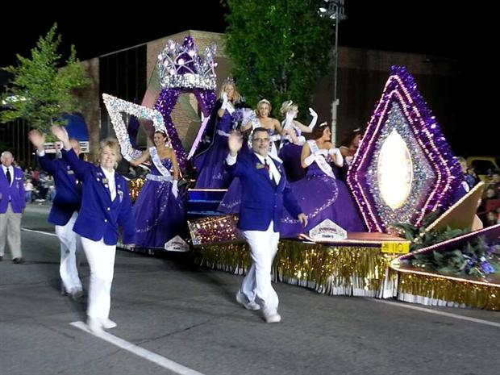
How does the Parade happen?
The Parade Krewe
The Parade Krewe

Slide 4
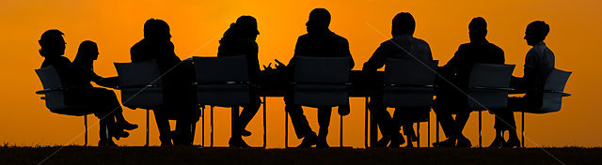
How does the Parade happen?
Through the dedication and hard work of over 40 volunteers
Parade season begins in November of the previous year, till the cleanup is done the day after the parade.
Coordination of Floats, Equestrians, Bands, Antique Cars, Commercial groups, Military groups and VIPs takes months of effort. Individuals responsible for their part in the parade are exceptional at their jobs.
NONE of this could happen as well as it does without us…
…their radio communications group.

Slide 5
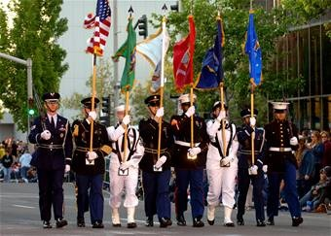
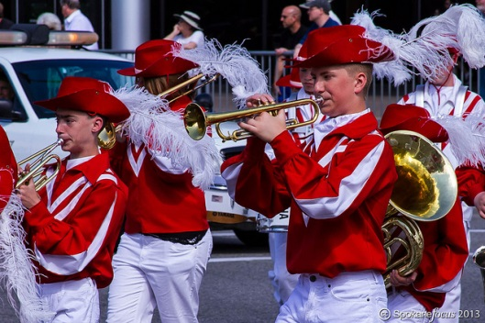
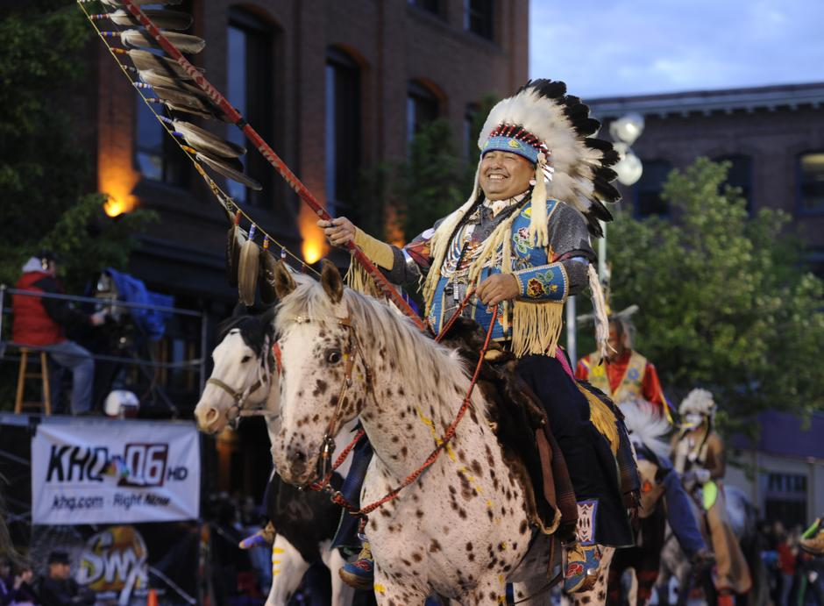
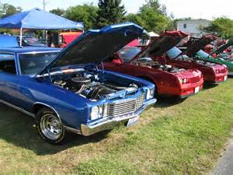
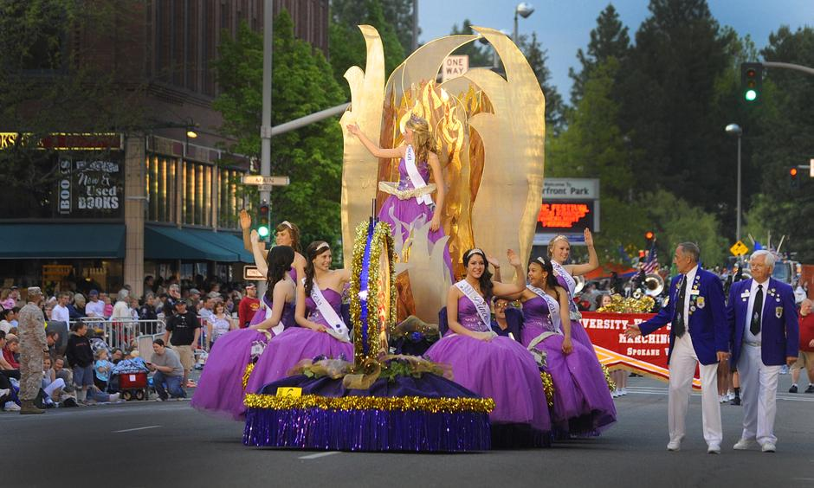
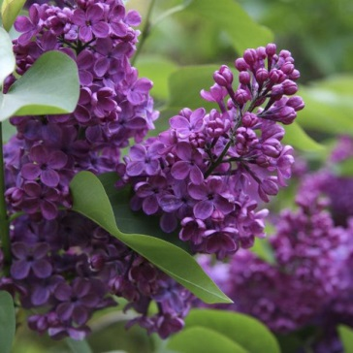
Who can be in the parade?
Dignitaries
Military dignitaries and groups
City and town floats
School Bands
School Floats
Non-Profit Organizations
Non-Political & Non-Religious
Antique and Showcase Cars

Slide 6
STAGING
The Line-Up

Slide 7

What does Staging do?
Staging is the process of lining up parade units in the proper order, giving them numbers and instructions in conduct.
It’s a LOT like herding cats…
…or assembling puzzles where the pieces have legs and move about as they want to, without regard for order.
Staging is a generic term given to the area ahead of Final Mix and prior to the Start Line.

Slide 8
What does Staging do?
Everyone in Staging works together to put the parade units in order, according to the Line-Up.
Following the Line-up is critical, and giving numbers to each unit is critical too. Numbers are placed on the ‘passenger’ side of the event unit (banner, dignitary car, float).
Each unit submitted an application to be part of the Lilac Parade. In that application, they provided a blurb or paragraph of text describing themselves. This is what is read off of the scripts at each of the Public Address stations and the TV location.
It is REALLY important that these match. If the script is not the same as the Line-Up, embarrassment ensues.

Slide 9
What does Staging do?
Changes to the Line-Up due to missing units, swaps or combinations need to be reported to Net Control as soon as they are confirmed.
The VP of the Parade will be notified of changes as soon as they become available.
Net Control will notify the PA and TV operators as soon as possible, so changes to the Line-Up and Script are made simultaneously.

Slide 10
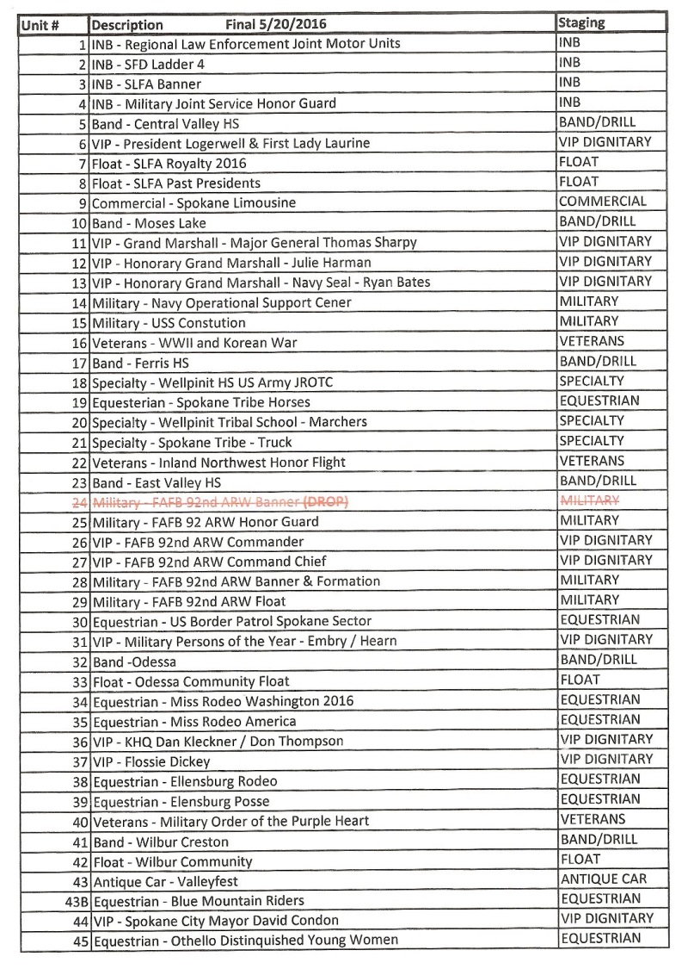
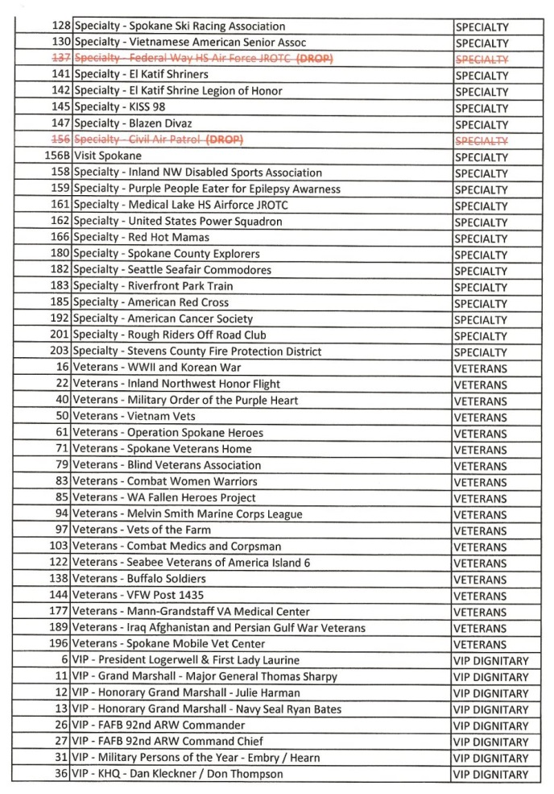
Numeric Line-Up
Line-Up by Group

Slide 11
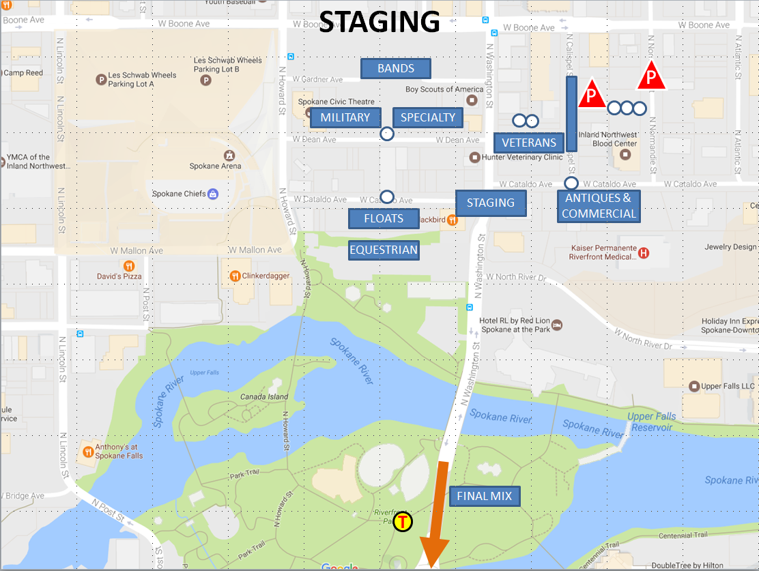

Slide 12
START LINE
The Parade Start

Slide 13
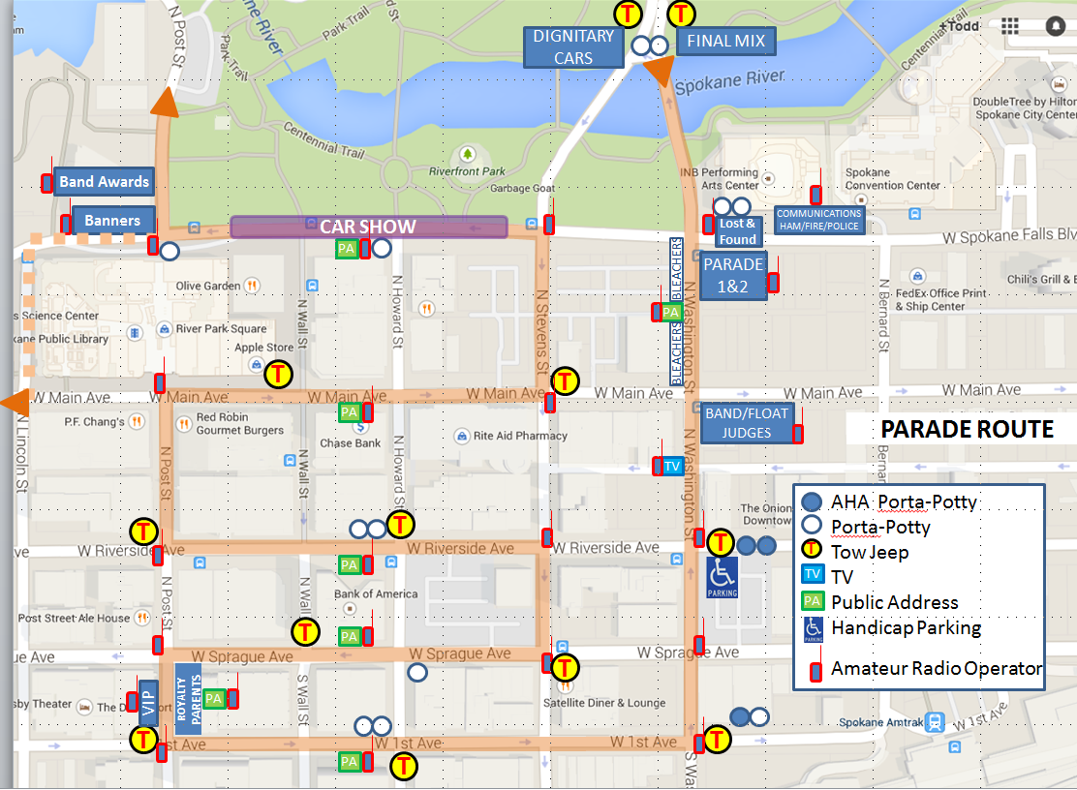

Slide 14
GOLF CARTS
Golf carts are for Parade use only, and the only folks allowed/insured to use them on Spokane City Streets are those that have their Drivers Licenses on file at the Parade Office.
The only cases where an unapproved person could use a Golf Cart is if you were instructed by a Parade Official to do so or there was an imminent danger to life/ property. Otherwise, you are the passenger and only providing radio communication for that driver.
The Parade Krewe has authorized us to use two of the Golf Carts to help shuttle Radio Operators to/from their vehicles, the Comm Van and their stations.

Slide 15
EMERGENCIES
Fire Comm
Emergency Communications take priority over all other communications.
If there is an emergency going on, maintain radio silence on the frequency in use for that emergency.
Urgent issues? call the Red Phone.

Slide 16
EMERGENCIES
Fire Comm
What Fire Comm needs to get help dispatched quickly:
Location of the situation (know your cross streets)
VERY BRIEF description of the situation
(Riot, Fire, Flood, Pregnancy, Injury)
If a person is involved, a HIPAA compliant description of victim – Sex, Approx. Age, Injury
NO NAMES!

Slide 17
HORSES – SHHHHH!
Equestrians
Please be quiet around the horses.
Please don’t spook or bother the horses.
Avoid walking up to Equestrian Units.
Treat as if they are Service Animals.
Help to remind Bands and Floats that loud music can cause problems for horses.

Slide 18
Proper ‘Netiquette’ and Conduct
Do we use VOX at any time during the parade?
NO
NO

Slide 19
Proper ‘Netiquette’ and Conduct
Net Control callsign is W7GBU
No VOX – please make sure it is PTT only.
Know where your PTT is – No Open Mic please!
Proper calling procedure is, “Hey You, It’s Me”
    Example: “Net Control, Staging 1”
Be prepared to be ‘Frequency Agile’ if asked or needed
Never give the frequencies by numbers over the air,
  only by tactical frequency name
Do not respond to malicious interference
Use your tactical call for brevity, finish with your FCC Callsign
All traffic goes through Net Control
Contact Net Control and be acknowledged before you begin to communicate your issue
Notify Net Control when you go off or come back on frequency
Always finish communications with your FCC Callsign

Slide 20
Proper ‘Netiquette’ and Conduct
For those ‘shadowing’ a Parade Official (Staging area, Final Mix, Start Line, OPS)
‘Stick like glue’ to that official but don’t crowd them
Follow their instructions, only communicate on their behalf
Always know where they are and how to reach them quickly
Always make yourself available to them
Always end communications with your FCC callsign
For those on Public Address stations: (TV, Public Address)
Stay at your position, call for relief if needed
Report any emergencies
Listen carefully as line-up changes and drops happen frequently
Be prepared to write down changes
Be prepared to repeat the change or question for clarification
Clearly communicate changes to the Announcer at your station.
To acknowledge a line-up change, simply give your FCC callsign.

Slide 21
Proper ‘Netiquette’ and Conduct
For Corner (CHARLIE) and Variable (VICTOR) stations:
Stay at your position, call for relief if needed
Listen for your callsign!
Report any emergencies
Report if you have a Tow Vehicle at your location
Only report parade gaps of unusual size (more than 2 blocks)
Use your tactical callsign to contact Net Control
Always finish communication with your FCC Callsign
All other Stations
(Bands, Band Awards, Banners, VIP, Lost & Found, Runner)
Stay at your position, call for relief if needed
Listen for your callsign!
Report any emergencies
Use your tactical callsign to contact Net Control
Always finish communication with your FCC Callsign

Slide 22
Parade Gap Mitigation
Parade gaps are not desirable, as it confuses the onlookers, and may cause them to think the parade is over, when in fact, there are more units to come.
Why do gaps happen?
Some units move faster than others
Some units move slower than others
Some units break down
Some units perform routines in place, which can cause large spaces in front of them
Occasionally there is a commercial break at the TV location, causing a gap to form

Slide 23
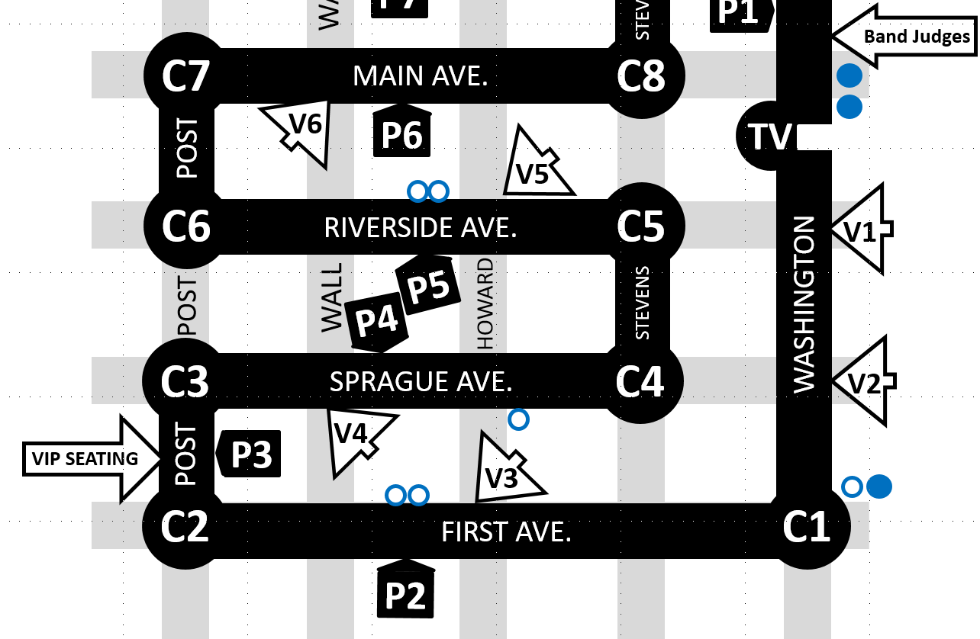
Parade Gap Mitigation
GAP!
GAP!
GAP!
GAP!
GAP!
GAP!
GAP!

Slide 24
Parade Gap Mitigation
When reporting a gap, call Net Control with your Tactical Call, report the gap length, location and the unit either in front of the gap or after it. Clear with your FCC Call.
Net Control will contact Charlie and Victor Stations further along the parade route to help mitigate or shrink the gap. Additional information on Parade Gap Mitigation is included in the handout you are given on Parade Day.

Slide 25
Parade Gap Mitigation
Victor 3, Go.
Net, Victor 3

Slide 26
Parade Gap Mitigation
Unit #?
Victor 3, Go.
Net, Victor 3
Gap. 2 blocks.

Slide 27
What to bring on Parade Day
Please be prepared for inclement weather AND nice weather.
Dress accordingly and in layers.
Bring your 2m radio (70cm option a bonus)
Spare batteries and/or spare radio
Good headphones or earbuds
User manual for the radio (if you need help programming it)
Water and Food
Medications if needed
Comfortable and portable chair if your position is stationary
Writing utensil and or clipboard if you need to take notes

Slide 28
What to bring on Parade Day
We meet at the Comm Van in the usual location – in front of the INB Performing Arts Center. Meet time is 5:00 pm (1700 hours).
There will be packets with the tactical map, instructions, parade gap mitigation information. The frequency list will be available then.
I’ll probably say a few words during that time.
If you need a ride from your parking location to the Comm van, or Comm van to your station and then back to your vehicle, we will have two carts operating this year.
Please be patient as we come to pick you up. Also, please be on frequency so we can coordinate pick-up.
Talk-in Frequency will be .

Slide 29
Safety and Security
In the past, we have received intentional interference on the frequencies we used for the Parade. Because of this, the actual frequencies in use will be discussed only in person, via phone, or in email but never over the air.
If there is someone who wants to know the frequencies, but are not part of the parade, please have them contact the coordinator. The Parade frequencies are not for general knowledge.
When referring to the frequencies over the air, use the tactical names for those frequencies, never the actual frequency numbers.
If someone causes interference, or has an open mic, wait for Net Control to direct you to change to Alternate or Backup frequencies.
If the frequency is in use and you have an emergency, call the Red Phone.

Slide 30
PARADE FREQUENCIES
Lilac Parade
“Primary VHF” Net:
    “VHF Simplex”:
    “Alternate VHF” Net:
    “Primary UHF” Net:
Backup Simplex
“Alpha” 14_.__
“Juliet” 14_.__
“Tango” 14_.__
“Xray” 14_.__
Red Phone
509-___-____

Slide 31
Fin
Thank You
For being a volunteer for the parade, but much more than that, for being willing to help make this parade the best in the nation!

