Slide 1
High-Speed, RF Based, Amateur Radio Emergency Data Network (AREDN) for Spokane County
Welcome to Ham Radio 2.0

Slide 2
What Technology Are We Talking About?
A mesh IP Network over RF in the 2.4, 3.4, and 5.8 gHz ham bands
Equipment is not traditional ham radio gear; instead, equipment used by wireless ISP’s that’s “opened up” to operate on ham bands
Radio output power is typically 600 milliwatts or less; antenna gains are regularly 15 to 34 db
Radio to computer connection is Ethernet.
Radio is powered using 12-24 volt Power over Ethernet (PoE)
Typical power consumption is 6-8 watts

Slide 3
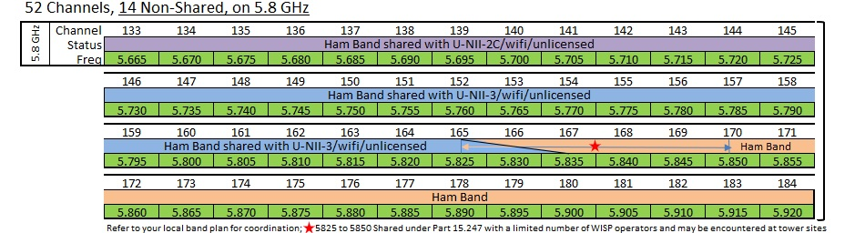
Part 15 and Part 97 Frequencies

Slide 4
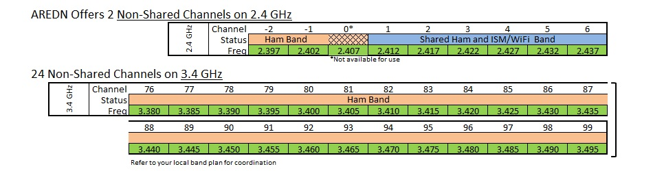
Part 15 and Part 97 Frequencies Cont’d

Slide 5
What’s Changed in the last 30 years?
Disaster and emergency management has moved from an informal, almost casual, local approach using whatever resources were available to a very standardized NIMS/ICS structure driven by county emergency management departments with escalation paths all the way to the federal level
Digital messaging and voice capabilities within the ham radio and emergency management community, have grown exponentially
Requirements for written communications and reporting have exploded
Technology and networking advances make commonplace today, what couldn’t be imagined in the 80’s and 90’s
Off the shelf, low cost, high speed RF data equipment that can operate effectively in the ham bands is readily available

Slide 6

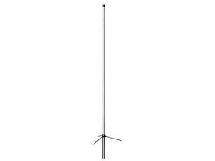
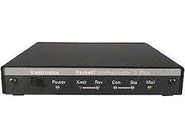
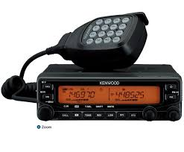
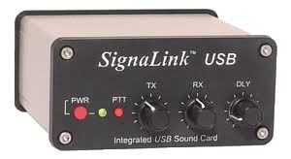
How Does the Equipment Compare to an AX.25 Packet Setup?
Typical AX.25 user setup
Computer connected to a TNC or sound card modem via a serial connection, then connected to a Radio via a brand specific protocol which is connected to an Antenna via coax

Slide 7
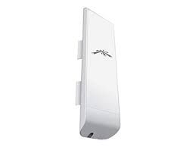
How Does the Equipment Compare to an AX.25 Packet Setup? Cont’d
A typical AREDN user setup
Computer connected via either an Ethernet cable or a Wi-Fi connection to a “node” which contains the TNC, radio, and antenna all in one package
Notes:
$81.76 at Amazon for either the 2.4 or 5.8 model

Slide 8
Goals and Rationale for This Work
Assumptions:
  Our AX.25 packet infrastructure in Eastern Washington is aging
  Support can be difficult and outage times unpredictable
  The amount of WinLink traffic generated in a full blown, county wide emergency would quickly and completely overload capacity
Goals:
  Build a more reliable, higher speed alternative based on today’s technology
  Provide emergency management leaders with the communication capabilities they need
    Situation assessment via chat and remote cameras
    High speed written communication
    Direct connectivity via a ham radio infrastructure

Slide 9
Random Facts
High power in Amateur Radio RF-mesh is 600 milliwatts (easily powered long term via small solar panel and battery even in multi radio locations)
Directional antennas are the norm, some with gain as high as 34 db
Unix-based controller, transceiver, and antenna often come as one unit
Some units have a separate antenna with the controller/transceiver mounted in/on it (have to keep RF cable runs very short)
Units are powered by Power-over-Ethernet (PoE) running on 12-24 volts
Long Ethernet runs require voltage on the higher end due to voltage drop on the run

Slide 10
Other Efforts in Spokane to build a High-Speed RF Data Network
Rod Ekholm, KC7AAD, has several nodes of a combination of Part 15 and Part 97 RF links on the 5.8 Ghz bands
That network is designed as a Point-To-Point and Point-To-Multipoint network (rather than mesh) following the HamWan model established in the Seattle area with the Puget Sound Data Ring (PSDR)
It terminates and connects to the internet in a data center in downtown Spokane
The HamWan model is designed for general ham radio use rather than specifically focused on emcomm
HamWan uses international, unlocked models of the equipment rather than rewriting the controller firmware
The two are not competing projects as much as different projects utilizing similar frequencies and equipment but being built for two different needs

Slide 11
Next Steps
An active working group is planning a proof of concept pilot to confirm the capabilities of this approach
  Connect the Spokane County DEM building to city hall in Latah
  Provide keyboard, voice and video chat between the two locations
  Provide situation assessment capabilities using a pan/tilt/20x zoom camera controlled from the DEM office
  Goal is to demonstrate this capability this October (date TBD)
Pending the outcome of the demonstration, the working group will propose a graduated build-out of AREDN in the Spokane County area, including linking to other AREDN groups in the future

Slide 12
Questions?
Discussion
Contact information:
  Del (WA7AQH) WA7AQH@gmail.com 510-517-4599
Links for more reading:
  https://www.arednmesh.org/
  https://www.facebook.com/groups/aredn/
  https://www.youtube.com/results?search_query=aredn+mesh+network

