Slide 1
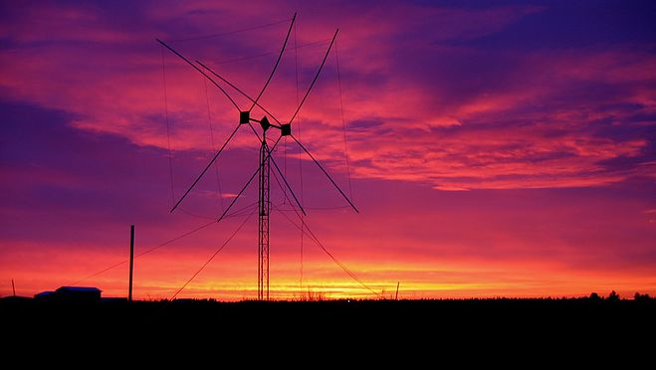
Initial Damage Assessment
Windshield Survey
How to conduct an initial damage assessment using Winlink forms
Photo by Gordon Grove – WA7LNC

Slide 2
Agenda
What is an Initial Damage Assessment
Do’s and Don’ts
Damage Definitions
Financial Estimating (hint: don’t do it)
Using the Winlink form for Initial Damage Assessment
Resources

Slide 3
What it is
  Initial damage assessment – The effort by local authorities to collect data related to the extent of damage within a jurisdiction
  Our Job – To visually estimate the number of damaged structures and what the severity of that damage may be based on given criteria

Slide 4
What to DO
  Verify damages with visual inspection
  Capture points Of contact
  Be sensitive discussing damages with property owners
  Consider impacts to businesses
  Ensure current assessments are accurate
  Balance your time, as efficiency is key
  Check with Coordinator on whether to wear government gear
  Know casualties in advance
  Stay in your lane when approached by media; refer to PIO
  Confirm damage occurred within the applicable incident period

Slide 5
What NOT to DO
DO NOT:
  Collect any Personally Identifiable Information
  Drive through flood waters
  Wear open toe shoes
  Visit any sites that would put you in an unsafe situation
  Make eligibility determinations in the field without proper leadership reviews
  Conduct assessments on tribal property or culturally significant sites or items without permission
  Talk to anyone about something you are unsure about
  Wear government gear if it is unsafe to do so
  Smoke on site inspections
  Wear excessive perfume when sharing cars

Slide 6
Defining Damage
Use your jurisdictions guidelines or these generic suggestions on habitable buildings. On other facilities get direction as needed
AFFECTED: Structure currently habitable. Cosmetic damage e.g. missing shingles. Generally less than $100 in damage. 0 to 6 inches of water in single-family dwelling.
MINOR: Structure currently uninhabitable. Will require minor repairs to be made habitable. 7 to 24 inches of water in structure and 0 to 6 inches of water in a mobile home.
MAJOR: Structure currently uninhabitable. Will require major repairs to be made habitable. 25 to 47 inches of water in a single-family dwelling or apartment. 7 to 23 inches of water in a mobile home.
TOTALED: Structure permanently uninhabitable. Cannot be repaired. 48 or more inches of water in a single-family dwelling or apartment. 24 or more inches of water in a mobile home

Slide 7
Defining Loss Estimates
ARES – ACS members will NOT perform any loss estimates or give anecdotal financial loss guesses
Estimating loss is not our job
Our job is to preliminarily estimate the percent of damage as defined in the previous slide, not estimate financial losses
Our job is to provide the right information at the right time to the right people for appropriate actions

Slide 8
Using Winlink Forms
Finding the Windshield Survey and WorkSheet in Winlink Forms

Slide 9
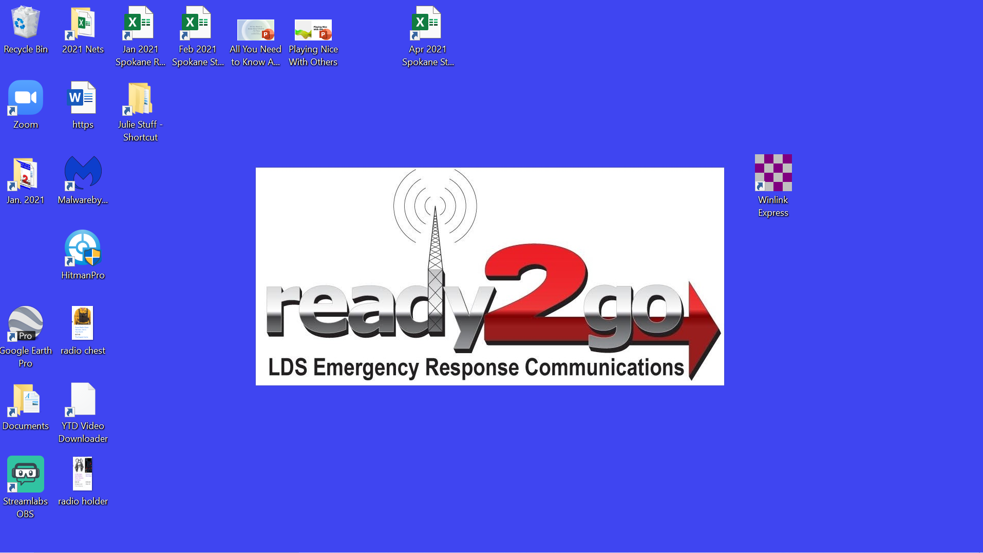

Slide 10
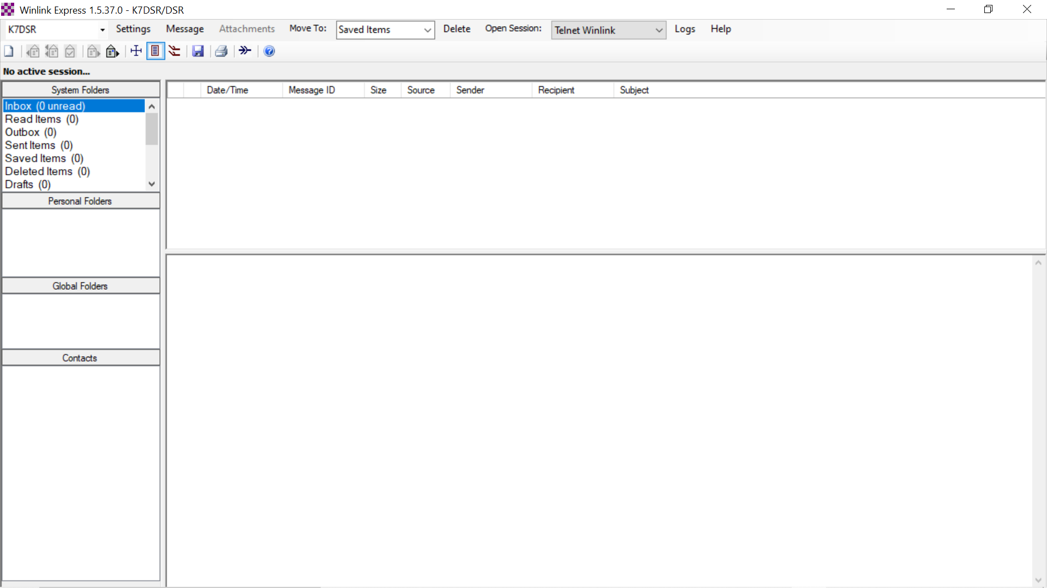
New Message Tab

Slide 11
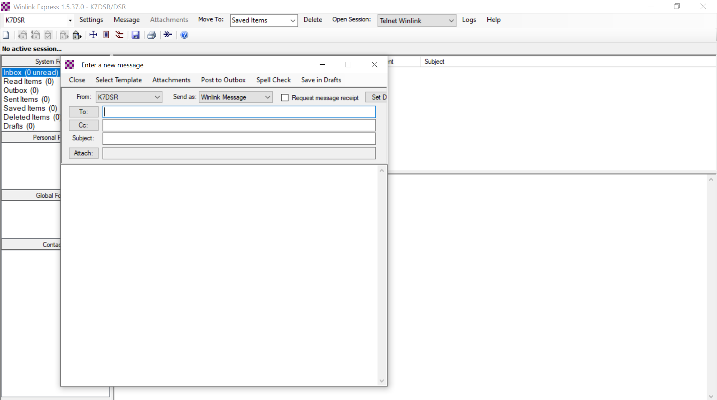
Select Template Tab

Slide 12
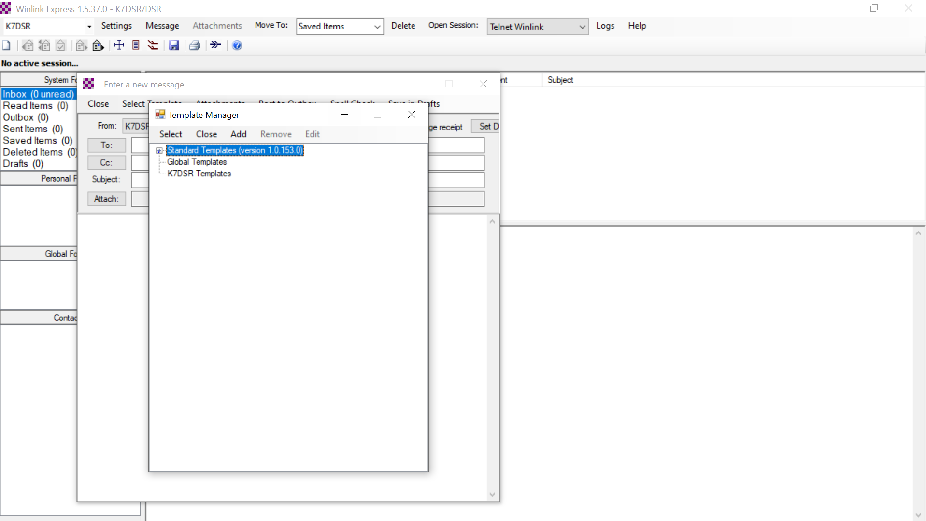
Standard Templates + sign

Slide 13
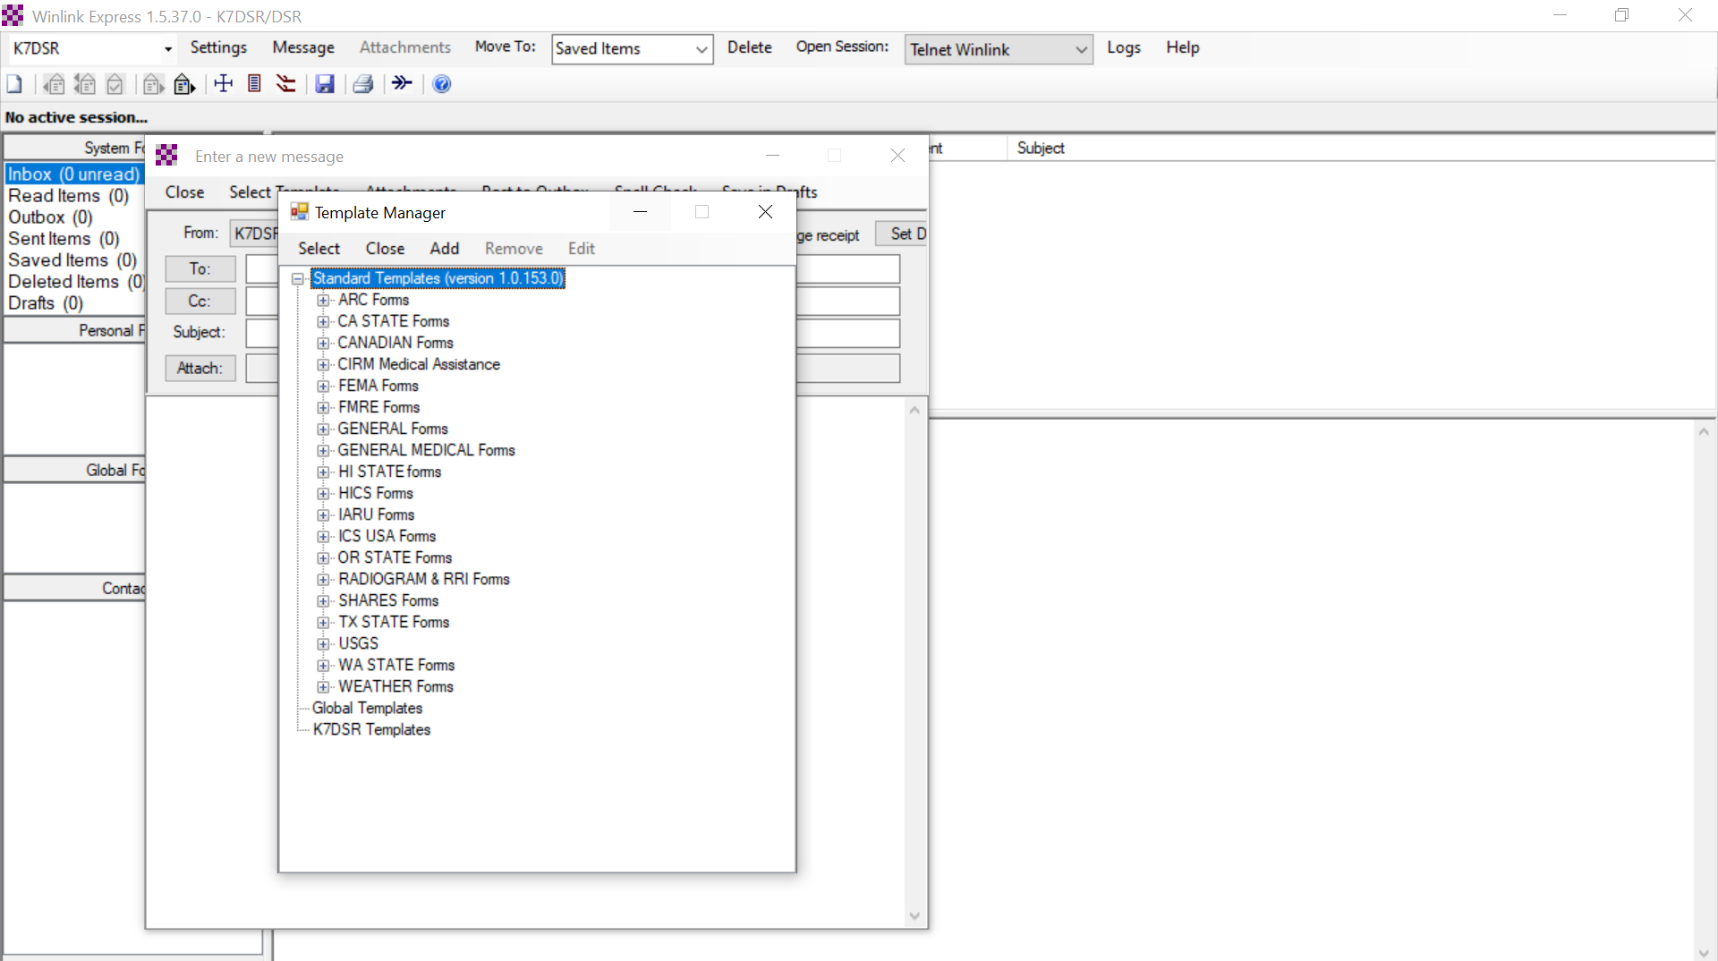
General Forms + sign

Slide 14
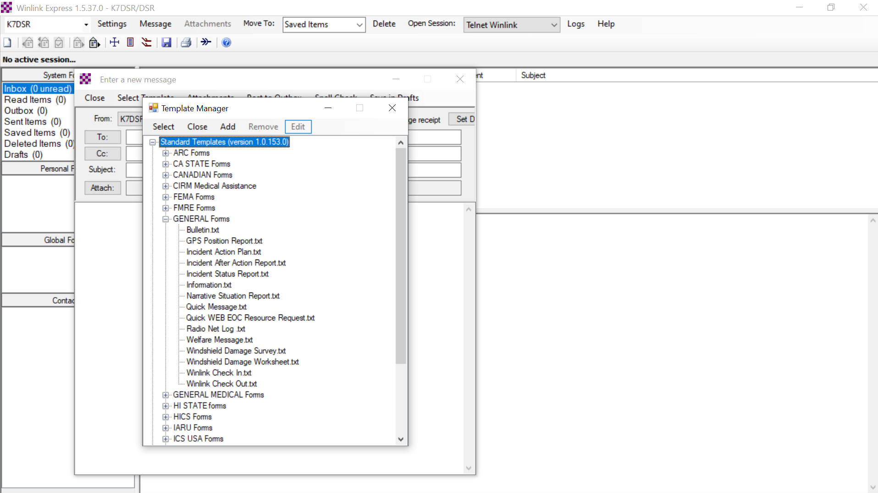
Windshield Damage Survey

Slide 15
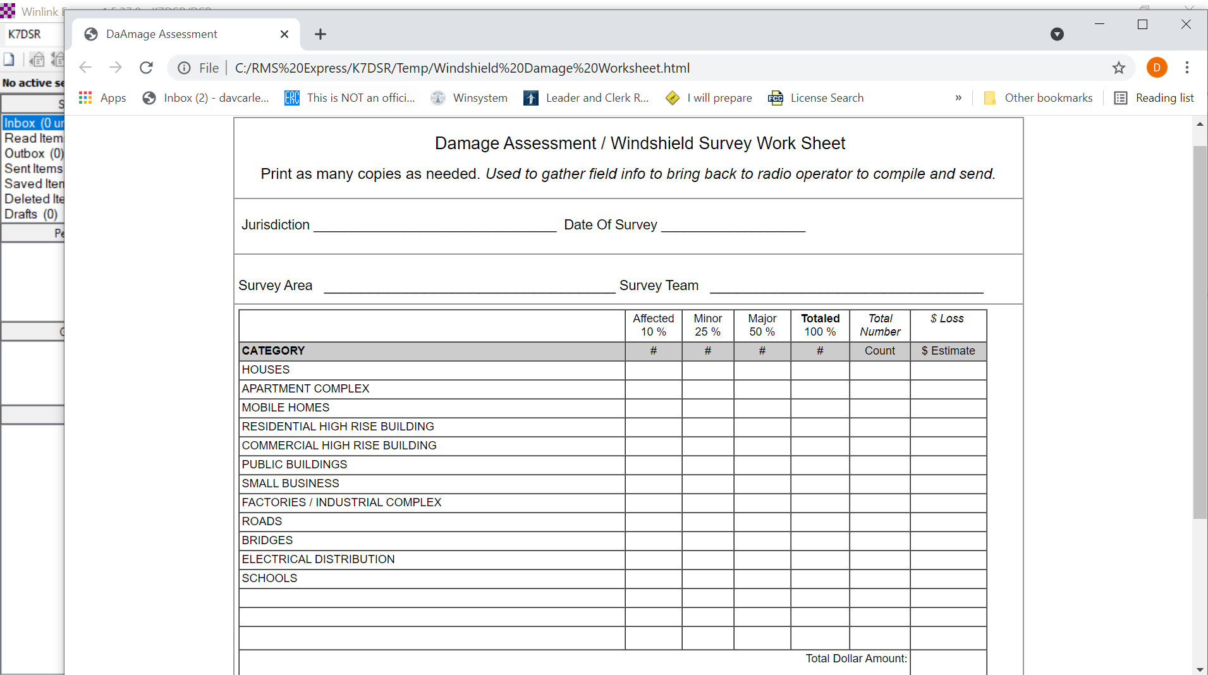

Slide 16
Windshield Damage Worksheet

Slide 17
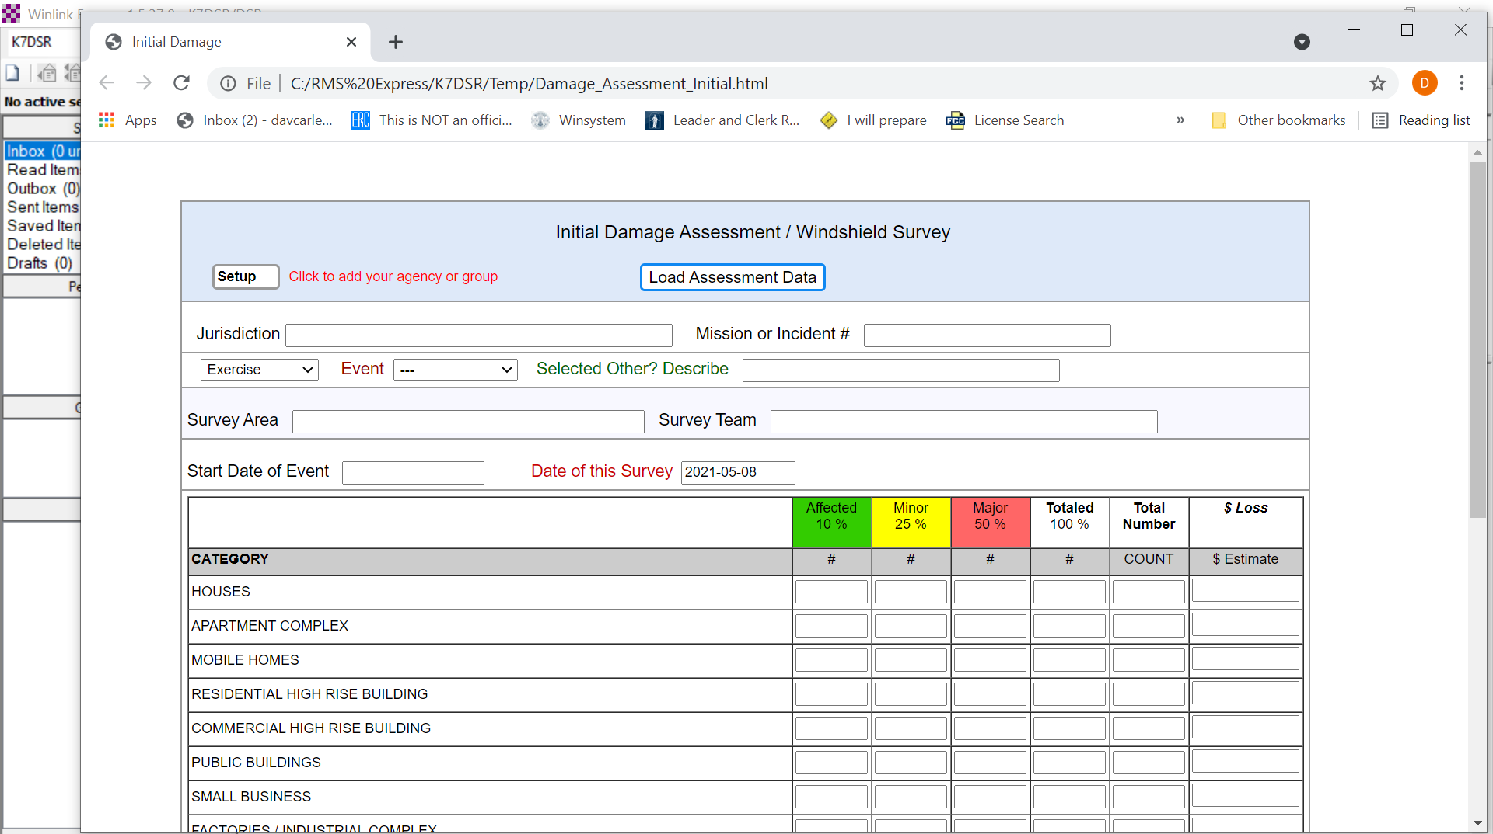

Slide 18
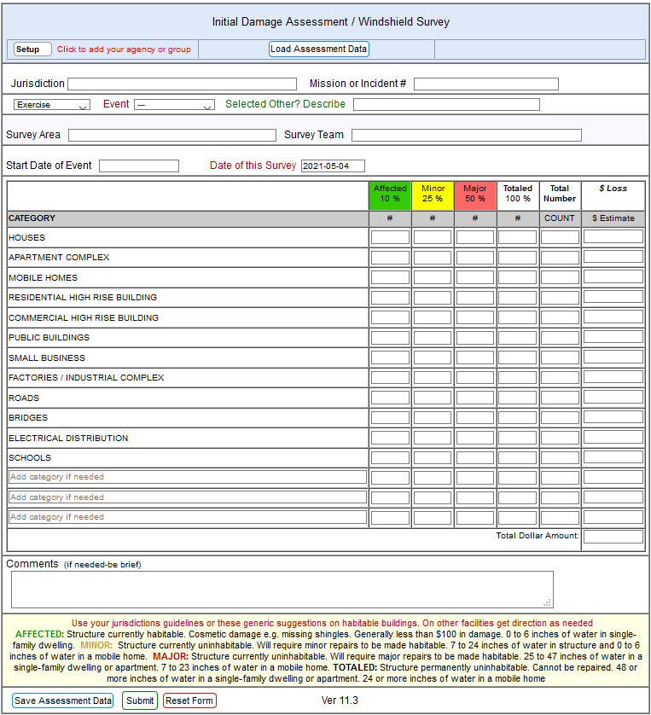
Using Winlink Forms
Jurisdiction: Spokane County (unless otherwise directed or assigned)
Mission or Incident number assigned
Select Exercise or Real World Event (as the case is)
Event: Select the nature of the event causing the damage
Survey Area, general description
  Neighborhood
  Cross-street location
  Geographical determinates
Survey Team: You and those working with you
Start Date: The date the event happened
Date of this Survey: The date you do the assessment
Estimate the number and types of buildings falling in the various damage categories

Slide 19
Resources
Winlink Form Location
  Winlink > New Message > Select Template > General Forms > Windshield Damage Survey.txt
Preliminary Damage Assessment Guide | FEMA.gov
Preliminary Damage Assessment Pocket Guide
REMEMBER:
  Keep paper copies of all necessary forms on-hand so you have them when needed
  Don’t rely on the Internet being up to get your forms

Slide 20

Questions

