Slide 1
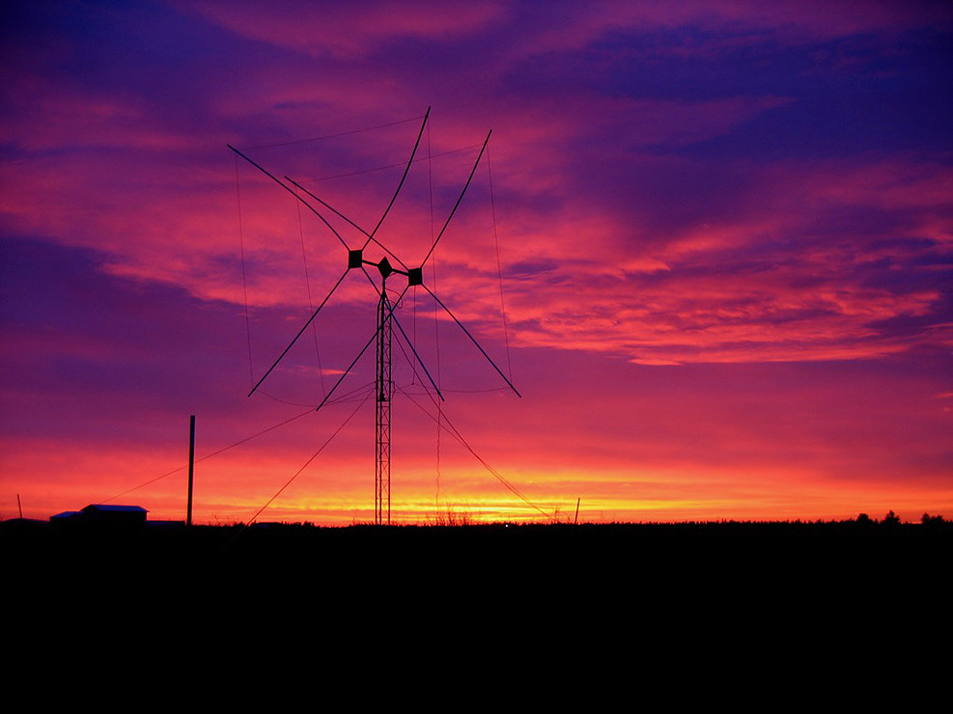
Ardop 101
A brief introduction to Ardop Winlink
Asa Jay Laughton - W7TSC

Slide 2
What is Ardop
Amateur Radio Digital Open Protocol
An open source, modern, amateur radio protocol intended for use across different operating systems and DSP devices for use with both HF and VHF transmissions (we’ll focus on HF)
For HF digital communications, it’s like Winmor, on steroids
Does not require a PACTOR or other hardware TNC modem
Is a “sound card” protocol that can be used with SignaLink and similar sound card interfaces (like the internal one found in the IC-7300)

Slide 3
Ardop Winlink Requirements
Latest version of Winlink
  EMCOMM operators should always be using the latest version of Winlink
  Q: What is, and do you have, the latest version of Winlink?
Your favorite HF radio with or without built-in sound card capability
A sound card modem like the SignaLink USB (for radios without one)
  Or a computer internal speaker/microphone hookup along with a PTT keyline (usually from a serial port)
No other software is required (such as UZ7HO soundmodem)
  The soundmodem TNC interface for Ardop is built-in to Winlink

Slide 4
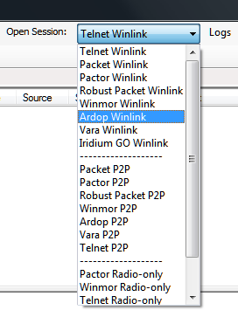
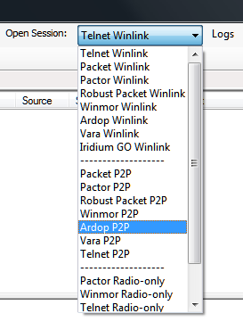
The Session Selections
Ardop Winlink
  Session option for connecting to a gateway station
  Emails addressed to anyone
Ardop P2P
  Session option for connecting to a peer
  Works like Packet P2P only with Ardop instead
  Only emails addressed to the station you are calling

Slide 5
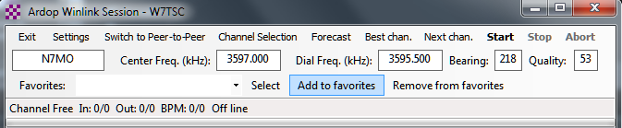
The Ardop Session Window
Similar look and feel to Winmor

Slide 6
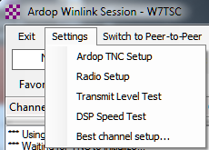
Quick Settings – from the session window
Ardop TNC setup
  What device and where
Radio Setup
  How you’ll control your radio
Transmit Level Test
  CAUTION: This will KEY your radio, so you can adjust transmit level

Slide 7
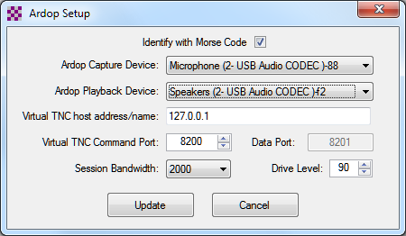
Ardop TNC Setup
These settings will transfer to the Ardop TNC configuration
  Ardop Window > File > Virtual TNC Setup
For Signalink USB, Select USB Audio CODEC
For other radios or sound control devices, select the appropriate com port or CODEC
Use defaults for all other settings

Slide 8
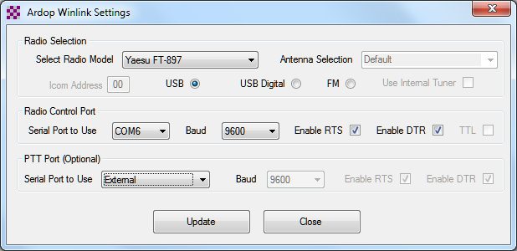
Radio Settings – example for Yaesu FT-897
Select settings that will match your radio
Note some settings will automatically default to the selected radio
Use Manual if no radio control is hooked up

Slide 9
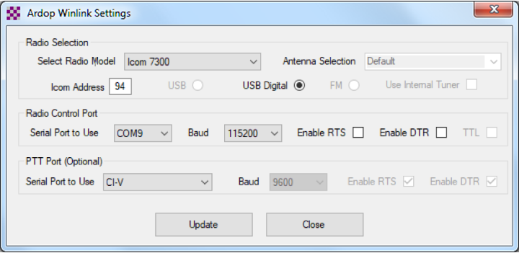
Radio Settings – example for Icom IC-7300
Select settings that will match your radio
Note some settings will automatically default to the selected radio
Use Manual if no radio control is hooked up

Slide 10
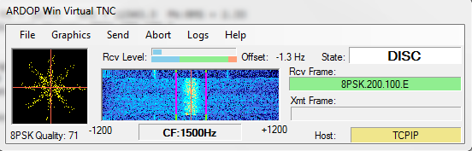
The Ardop Virtual TNC
Opens as a separate window
Opens minimized
Receive level indicator
Waterfall or Spectrum display
Link Quality assessment
Transmit and Receive Frame info

Slide 11
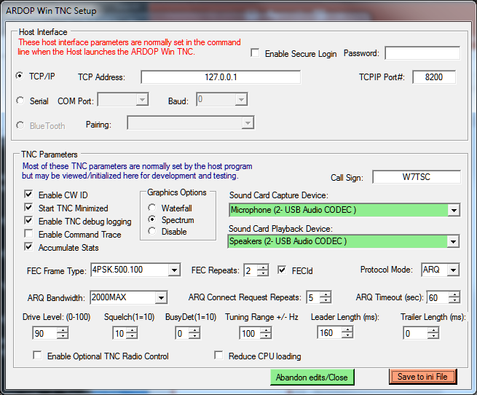
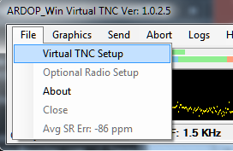
Advanced Config for Ardop TNC
More detailed settings

Slide 12
Time For...
Video of Ardop in action
Live demonstration

Slide 13
Resources
https://www.winlink.org/content/ardop_overview
https://www.tapr.org/pdf/DCC2015-ARDOP-KN6KB-N8OHU-GM8BPQ.pdf
https://ardop.groups.io/g/users

Slide 14

Questions
https://spokares.org
W7TSC@arrl.net

