Slide 1

National Response Framework
An Introduction
IC-800
Prepared by:
Frank E. Hutchison, AG7QP
February 20, 2020

Slide 2
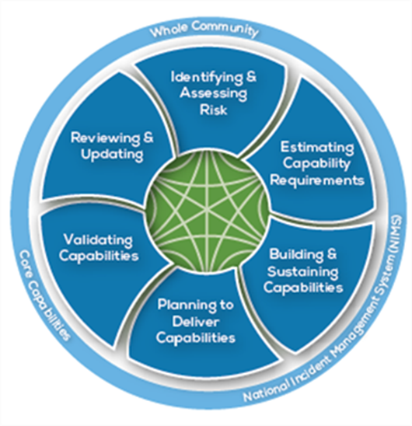
Background
The National Preparedness Goal
A secure and resilient Nation with the capabilities required across the whole community to prevent, protect against, mitigate, respond to, and recover from the threats and hazards that pose the greatest risk. (IC-2000)
The National Preparedness System
An organized process to achieve the National Preparedness Goal. An integrated set of guidance, concepts, processes, and tools to meet the National Preparedness Goal. Has six parts:
    Identifying and Assessing Risk
    Estimating Capability Requirements
    Building and Sustaining Capabilities
    Planning to Deliver Capabilities
    Validating Capabilities
    Reviewing and Updating

Slide 3
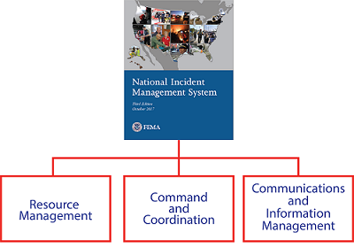
National Incident Management System
Comprehensive approach guiding the whole community to work together to prevent, protect against, mitigate, respond to, and recover from the effects of incidents. (IC-700)
The NIMS guiding principle of standardization supports interoperability among multiple organizations in incident response. Defines:
Standard organizational structures
Standard practices
Common terminology
Major Components of NIMS are
  Resource Management
  Command and Coordination
  Communications and Information Management
Incident Command System is the application to incidents (IC-100 and IC-200)

Slide 4
What’s Between NPG and NIMS?
The National Preparedness Goal describes what we want to achieve – NOT how to achieve.
The HOW to achieve is described by a Framework in each of the five mission areas:
  Prevention
  Protection
  Mitigation
  Response
  Recovery

Slide 5
National Response Framework
A guide to how the Nation responds to all types of disasters and emergencies. It is built on scalable, flexible, and adaptable concepts identified in NIMS to align key roles and responsibilities across the Nation. (IC-800)
At the Federal level, supported by the Response Federal Interagency Operational Plan (FIOP).
Describes principles, roles and responsibilities, and coordinating structures for delivering the core capabilities required to respond to an incident.
Always in effect, and elements can be implemented at any level and at any time according to the unique needs, capabilities, demographics, and governing structures of the jurisdiction.
Applied in actual and stimulated response situations.

Slide 6
Response Definition
• Actions to save lives, protect property and the environment, stabilize communities, and meet basic human needs following an incident
• The execution of emergency plans and actions to support short-term recovery

Slide 7
Guiding Principles for Response
Response doctrine defines basic roles, responsibilities, and operational concepts for Response across all levels of government and with the private sector and nongovernmental organizations.
The overarching objective of Response activities is
Ensuring life safety
Protecting property and the environment
Stabilizing the incident
Providing for basic human needs.
Guiding Principles are:
Engaged Partnership
Tiered Response
Scalable, Flexible, and Adaptable Operational Capabilities
Unity of Effort Through Unified Command
Readiness To Act
Risk Basis (Cascading Events)
Notes:
As a team effort, Unified Command allows all agencies with jurisdictional authority and/or functional responsibility for the incident to provide joint support through mutually developed incident objectives and strategies. Each participating agency maintains its own authority, responsibility, and accountability.
The National Response Framework leverages the findings from the Strategic National Risk Assessment (SNRA) to build and deliver the response core capabilities. The SNRA indicates that a wide range of threats and hazards continues to pose a significant risk to the nation, affirming the need for an all-hazards, capability-based approach to preparedness planning. Key findings include:
• Natural hazards, including hurricanes, earthquakes, tornadoes, drought, wildfires, winter storms, and floods; climate change has the potential to cause the consequences of weather-related hazards to become more severe
• A virulent strain of pandemic influenza
• Technological and accidental hazards, such as transportation system failures, dam failures, or chemical spills or releases
• Terrorist organizations or affiliates possibly seeking to acquire, build, and use weapons of mass destruction (WMD)
• Cybersecurity threats exploiting the increased complexity and connectivity of critical infrastructure systems, placing the nation’s security, economy, and public safety and health at risk
Some incidents, such as explosives attacks or earthquakes, generally causing more localized impacts; other incidents, such as human pandemics, possibly causing impacts that are dispersed throughout the nation

Slide 8
Roles and Responsibilities of Partners
Response Partnerships - response partners work together to meet incident management challenges
Individuals, Families, and Households
Communities
NonGovernmental Organizations (NGOs)
The Private Sector
Local Governments
State, Tribal, Territorial, Insular Area Governments
Federal Government

Slide 9
Core Capabilities
The National Preparedness Goal defines core capabilities.
In the National Response Framework
The core capability is function/activity to be accomplished.
The objective is the intended outcome for this function.
The critical tasks are steps to achieve the objective.
Three core capabilities span across all five mission areas:
Planning
Public Information and Warning
Operational Coordination
Notes:
The National Response Framework is intended to strengthen, organize, and coordinate response actions across the entire response community as a means of delivering the core response capabilities.
Once an incident occurs, efforts focus on:
• Saving lives
• Protecting property and the environment
• Preserving the social, economic, cultural, and political structure of the jurisdiction
Response core capabilities are the functions or activities that generally must be accomplished in incident response regardless of which levels of government are involved.
The cross-cutting core capabilities are essential to the success of the other core capabilities. They help unify the five mission areas and establish unity of effort among all those involved in the Response mission area.

Slide 10
Described in detail in other courses
Core Capabilities
Planning
Public Information and Warning
Operational Coordination
Forensics and Attribution
Intelligence and Information Sharing
Interdiction and Disruption
Screening, Search, and Detection
Access Control and Identity Verification
Cybersecurity
Physical Protective Measures
Risk Management for Protection Programs and Activities
Supply Chain Integrity and Security
Community Resilience
Long-term Vulnerability Reduction
Risk and Disaster Resilience Assessment
Threats and Hazards Identification
Critical Transportation
Environmental Response/Health and Safety
Fatality Management Services
Fire Management and Suppression
Infrastructure Systems
Logistics and Supply Chain Management
Mass Care Services
Mass Search and Rescue Operations
On-scene Security, Protection, and Law Enforcement
Operational Communications
﻿Public Health, Healthcare, and Emergency Medical Services
Situational Assessment
Economic Recovery
Health and Social Services
Housing
Natural and Cultural Resources
Response Core Capabilities in Bold
Notes:
Interdependencies exist among many of the core capabilities:
• Organizations involved in providing Mass-Care Services often rely on resources and functions from organizations that provide Critical Transportation or Logistics and Supply Chain Management for commodities distribution.
• Public Information and Warning provides for messaging, translators, and interpreters, as well as Operational Communications for reporting and communication that allows shelters to stay in touch with operations centers.
The core capabilities in various mission areas may also be linked through shared assets and services.
The functionality provided by geographic information systems can be applied across multiple Response core capabilities.
Synergy among mission-area resources and processes is important to maximize capabilities and minimize risk.

Slide 11
Coordinating Structures
Coordinating structures help organize and measure the whole community’s capabilities in order to:
Address the requirements of the Response mission area
Facilitate problem solving
Improve access to response resources
Foster coordination prior to and following an incident
The coordinating structures used to organize response efforts must be scalable, flexible, and adaptable so they can be partially or fully implemented to allow for delivery of the exact resources that are needed, and with a level of coordination appropriate to each incident.

Slide 12
All Levels Have Coordinating Structures
Local
State, Tribal, and Territorial
Private-Sector
Federal

Slide 13
Emergency Support Functions
Coordination of Federal incident response is accomplished through Emergency Support Functions (ESFs). ESFs are organized groups of government and private-sector entities that provide personnel, supplies, facilities, and equipment.
Federal ESFs bring together the capabilities of Federal departments and agencies and other national-level assets that work together to deliver core capabilities and support an effective response.
Within each ESF, an ESF coordinator, primary agency, and support agencies are designated. Overall leadership is provided by the Emergency Support Function Leaders Group.
Departments and agencies supporting Federal ESFs may be selectively activated to support response activities for both Stafford Act and non-Stafford Act incidents. Not all incidents requiring Federal support result in the activation of ESFs.

Slide 14
Local Operations Coordination
A basic premise is that incidents generally begin and end locally, and most incidents are managed entirely at the local level.
Local responders and other levels of government use the Incident Command System, or ICS, to manage response operations.
The Incident Commander communicates with the local emergency operations center, or EOC, to report on the incident status and request resources.
During an incident, the local emergency manager ensures the EOC is staffed to support the incident command and arranges needed resources.
The chief elected or appointed official provides policy direction and supports the Incident Commander and emergency manager, as needed.

Slide 15
When an Incident Grows
1. Local mutual aid and assistance resources
Multiagency Coordination (MAC) Groups
2. State Resources
3. Federal Resources
Coordinating structures can be assembled and organized at the regional level
  Regional Response Coordination Centers
  Joint Field Office
    Unified Coordination Group
National Response Coordination
  Agency, FEMA, NMCC, FBI

Slide 16
Operational Planning
Planning across the full range of homeland security operations is an inherent responsibility of every level of government
Operational planning is conducted across the whole community, including:
• The private sector
• NGOs
• All levels of government

Slide 17
Conclusion
The environment in which the nation operates grows ever more complex and unpredictable.
Partners are encouraged to develop a shared understanding of broad-level strategic implications as they make critical decisions in building future capacity and capability.
The whole community should be engaged in examining and implementing the strategy and doctrine considering both current and future requirements in the process.

Slide 18
Questions?

