Slide 1

An Introduction to the National Incident Management System
IC-700.b
Prepared by:
Frank E. Hutchison, AG7QP
February 20, 2020

Slide 2
Fundamentals and Concepts of NIMS
WHAT?
Defines the comprehensive approach
WHO?
The whole community
WHY?
To prevent, protect against, mitigate, respond to, and recover from the effects of incidents.
WHEN?
Applies to all incidents, regardless of cause, size, location, or complexity, from planned events to traffic accidents and to major disasters.
HOW?
Provides the shared vocabulary, systems, and processes to successfully deliver the National Preparedness System capabilities.

Slide 3
The audience for NIMS includes:
• Emergency responders
• Other incident personnel
• Non-Governmental Organizations (NGOs)
  Faith-based and
  Community-based groups
• The private sector
• Elected and appointed officials
• People with disabilities or access and functional needs
In short,
EVERYONE

Slide 4
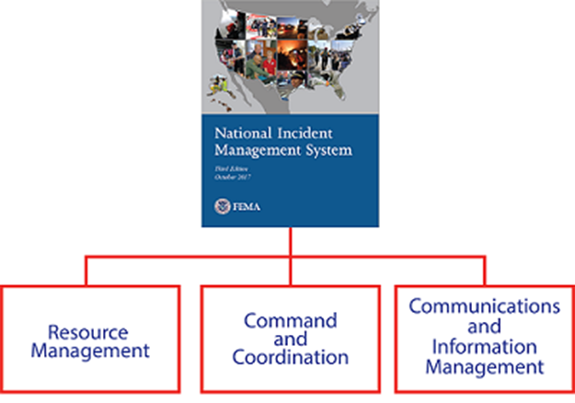
NIMS
Guiding Principles
• Flexibility
• Standardization
• Unity of Effort
Major Components

Slide 5
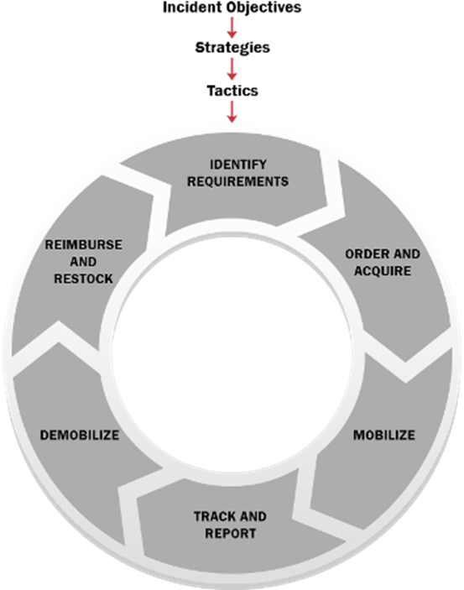
NIMS Resource Management
During the Incident
Before the Incident
Resource management preparedness involves four key activities:
• Identifying and typing resources
• Qualifying, certifying, and credentialing personnel
• Planning for resources
• Acquiring, storing, and inventorying resources

Slide 6
Mutual Aid
Mutual aid agreements establish the legal basis for two or more entities to share resources. Various forms of mutual aid agreements and compacts exist among and between all levels of government in the United States and
Internationally
Between government and NGOs and/or the private sector
Among NGOs and/or private sector entities
Process:
Upon receipt of a request, evaluate the request against capacity.
Able to meet its own requirements during the temporary loss of the resource(s).
If can, identify and arrange the deployment in accordance with the mutual aid agreement.
The receiving jurisdiction can decline resources if they do not meet its needs.

Slide 7
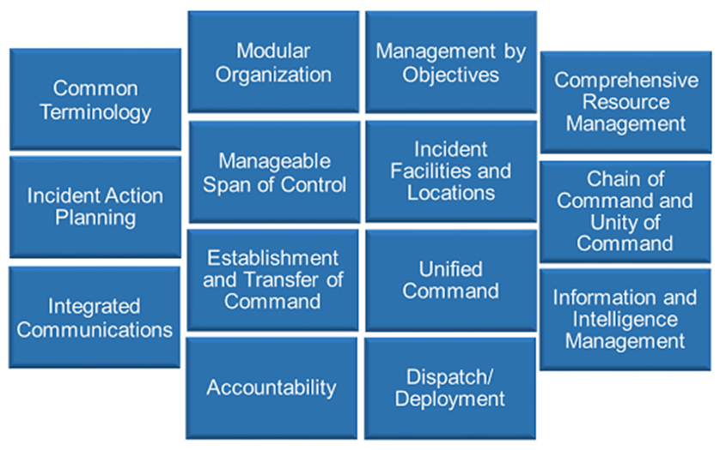
NIMS Management Characteristics

Slide 8
Four NIMS structures
When an incident occurs or threatens, local emergency personnel manage response using ICS.
If the incident is large or complex, off-site EOCs activate to support on-scene operations.
The incident personnel in the field and in EOCs receive policy guidance from MAC Groups.
A Joint Information Center manages the Joint Information System (JIS) to ensure coordinated and accurate public messaging among all levels: ICS, EOC and MAC Group.

Slide 9
Incident Command System (ICS)
The Incident Command System (ICS) provides:
• A standardized approach to the command, control, and coordination of on-scene emergency management
• A common structure within which personnel from different organizations can work together
• A structure for incident management that integrates and coordinates procedures, personnel, equipment, facilities, and communications
ICS is used by all levels of government and many NGOs and private sector organizations.
This system includes five major functional areas: Command, Operations, Planning, Logistics, and Finance/Administration.
There are two general forms of the incident command function:
• A single Incident Commander
• A Unified Command

Slide 10
Unified Command
Each partner in the Unified Command maintains authority, responsibility and accountability for its own personnel and other resources, but the members of the Unified Command work together to:
• Determine objectives, priorities and strategic guidance
• Establish a single system for ordering resources
• Execute integrated incident operations
• Maximize the use of assigned resources

Slide 11
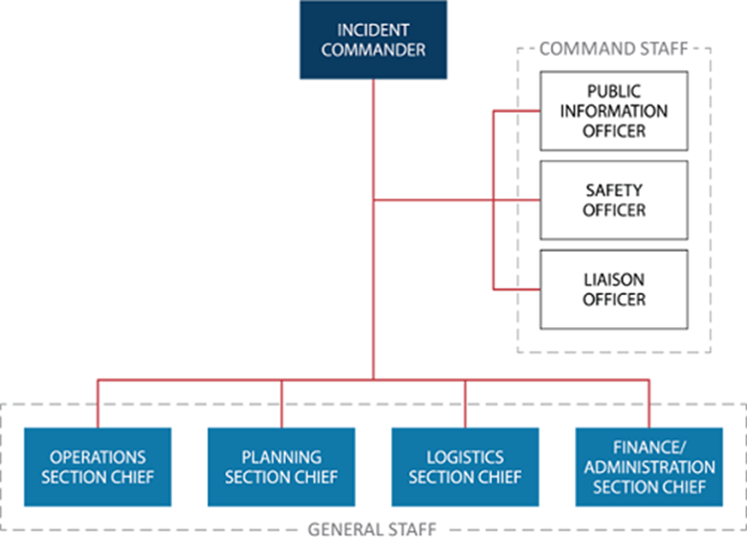
Command Structure

Slide 12
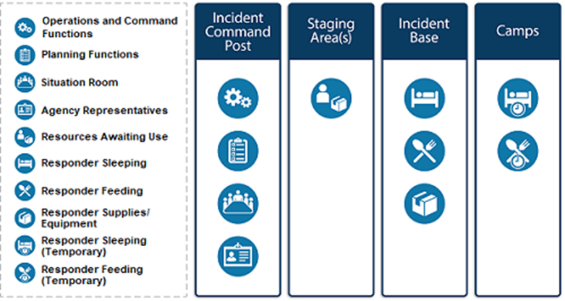
Common Types of ICS Facilities

Slide 13
Incident Management Teams
Incident Management Teams (IMT) are a rostered group of ICS-qualified personnel composed of an Incident Commander, other incident leadership, and personnel qualified for other key ICS positions.
Incident Management Assistance Teams support on-scene personnel and/or the affected jurisdiction(s).
Area Command organization oversees the management of multiple incidents or a very complex incident through establishing multiple ICS organizations.

Slide 14
Emergency Operations Centers (EOC)
EOCs are off site locations where staff from multiple agencies come together to:
Address imminent threats and hazards
Provide coordinated support to incident command, on-scene personnel and/or other EOCs
The purpose, authorities, and composition of EOCs vary widely, but EOCs generally perform the following primary functions:
Collecting, analyzing and sharing information
Supporting resource needs and requests, including allocation and tracking
Coordinating plans and determining current and future needs
In some cases, providing coordination and policy direction

Slide 15
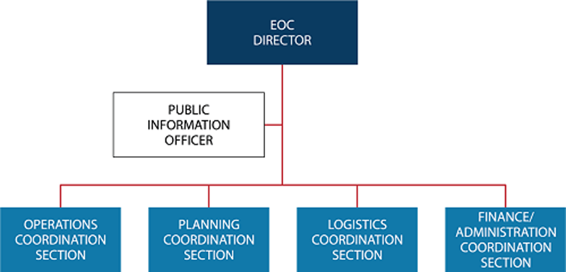
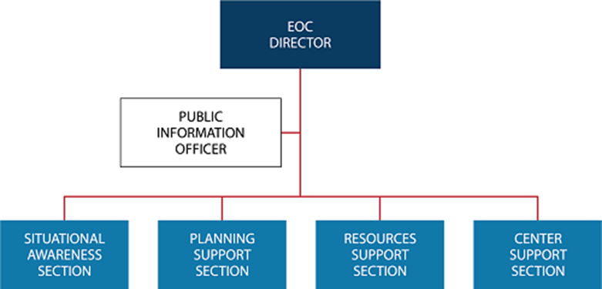
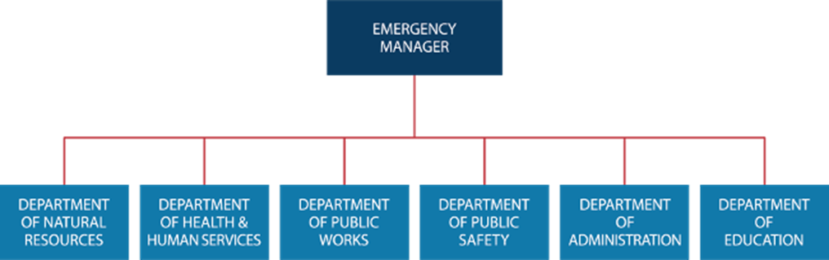
EOC Organizational Structures
NIMS identifies three common ways of organizing EOC Teams:
ICS or ICS-like structure
Incident Support Model structure
Departmental structure

Slide 16
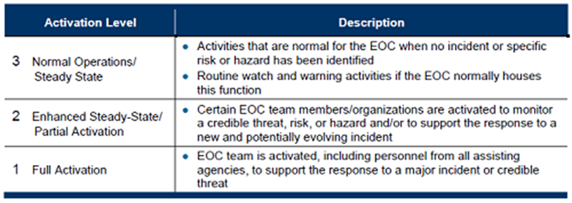
EOC Activation Levels

Slide 17
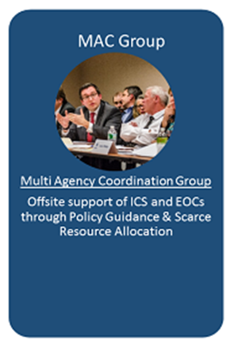
Other NIMS Structures
Joint Information System (JIS) activities include:
Developing and delivering coordinated interagency messages
Developing, recommending and executing public information plans and strategies
Advise on public affairs issues that could affect the incident management effort
Addressing and managing rumors and inaccurate information that could undermine public confidence
Public Information Officer (PIO) and Joint Information Center (JIC) are supporting elements

Slide 18
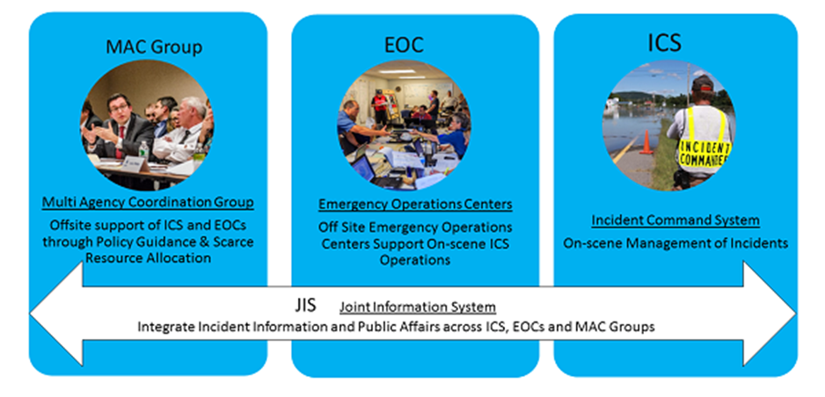
Interconnectivity
Interconnectivity of NIMS structures is important to allow personnel in diverse geographic areas, with differing roles and responsibilities, and operating within various functions of ICS and/or EOCs to integrate their efforts through common organizational structures, terminology, and processes.

Slide 19
Communications and Information Management
Four key communications and information systems principles:
Interoperability
Reliability, Scalability, and Portability
Resilience and Redundancy
Security
Communications Management Characteristics
Standardized Communications Types: Strategic; Tactical; Support; Public
Policy and Planning
Agreements
Equipment Standards
Training
Incident Information
Communications Standards and Formats

Slide 20
Questions?

