Slide 1
IS-100c Course Overview
An introduction to the Incident Command System (ICS) used nationwide to manage incidents regardless of size or type.
IS-100c is the first in a series of ICS courses for all personnel involved in incident management. Descriptions and details about the other ICS courses in the series may be found on the FEMA web site: http://training.fema.gov.
This will be a brief overview of IS-100c and include 4 Units. Unit 5 of the actual course is an extended on-line exercise to self-test your knowledge prior to taking the final exam.

Slide 2
Unit 1: IS-100c Course Overview
Main objectives:
  IS-100.c provides information on ICS which is part of the National Incident Management System (NIMS)
  ICS is a standardized management tool that allows better coordination and use of resources.
  ICS represents organizational best practices and has become the standard for emergency management.
  ICS can be used to manage the response for all incidents and planned events.
  NIMS management characteristics are the foundation of the ICS.

Slide 3
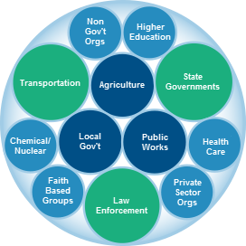
Whole Community Approach
The Federal Government is only one part of the whole community that must be involved in preparing for, protecting against, responding to, recovering from, and mitigating any and all incidents
The Whole Community approach ensures solutions are implemented and resources used efficiently from those in all levels of government as well as non-governmental and private-sector organizations in fields such as transportation, health care, schools, public works, communications, agriculture, chemical/nuclear, and more.

Slide 4
What is ICS and When is it Used?
The Incident Command System (ICS) is a standardized approach to incident management that:
  Is used for all kinds of incidents by all types of organizations and at all levels of government; ICS is applicable to small incidents as well as large and complex ones.
  Can be used to manage emergencies or any other type of incident, including a planned event regardless of their size or cause.
  Enables a coordinated response among various jurisdictions and agencies.
  Establishes common processes for incident-level planning and resource management.
  Allows for the integration of resources (such as facilities, equipment, personnel) within a common organizational structure
  As a system, ICS guides the process for planning, building, and adapting the incident response structure.
Using ICS for every incident or planned event provides the practice that will help to maintain and improve skills needed to effectively coordinate larger or more complex efforts.

Slide 5

Promoting Response Partnerships

Slide 6
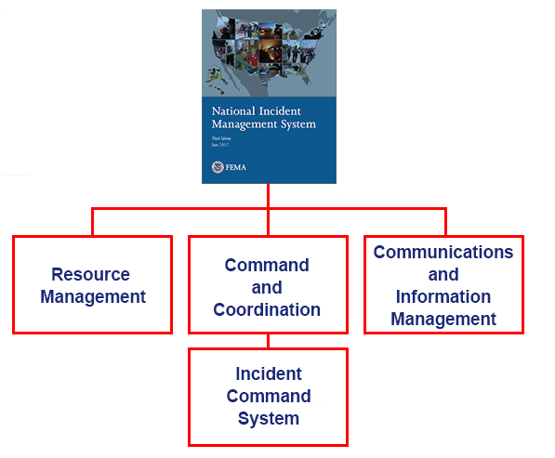
ICS - part of National Incident Management System (NIMS)
The National Incident Management System (NIMS) is a systematic, proactive approach to guide all levels of government, nongovernmental organizations (NGOs), and the private sector to work together to prevent, protect against, mitigate, respond to, and recover from the effects of incidents. NIMS provides a consistent foundation for all incidents, ranging from daily occurrences to incidents requiring a coordinated Federal response.
NIMS is organized into three major components:
  Resource Management
  Command and Coordination - including the Incident Command System (ICS)
  Communications and Information Management
It is important to note that the Incident Command System (ICS) is just one part of NIMS.

Slide 7
Benefits of ICS Built on Best Practices
The Incident Command System (ICS) has positively impacted incident management efforts through testing over more than 40 years of emergency and nonemergency incidents by all levels of government; and in nongovernmental and private-sector organizations by:
  Clarifying chain of command and supervision responsibilities to improve accountability
  Leveraging interoperable communications systems and plain language to improve communications
  Providing an orderly, systematic planning process
  Implementing a common, flexible, predesigned management structure
  Fostering cooperation between diverse disciplines and agencies
ICS helps to ensure:
  The safety of responders, community members, and others
  The achievement of incident objectives
  The efficient use of resources

Slide 8
Unit 2: NIMS Management Overview

Slide 9
NIMS Management Characteristics: Overview
The Incident Command System (ICS) is based on the following 14 proven NIMS management characteristics, each of which contributes to the strength and efficiency of the overall system:
 | Common Terminology Modular Organization Management by Objectives Incident Action Planning Manageable Span of Control Incident Facilities and Locations Comprehensive Resource Management | Integrated Communications Establishment and Transfer of Command Unified Command Chain of Command and Unity of Command Accountability Dispatch/Deployment Information and Intelligence Management

Slide 10


Management Characteristics
Common Terminology promotes understanding among all parties involved in managing an incident by using common terms, avoiding radio codes, agency-specific codes, acronyms, or jargon.
  Organizational Functions: Major functions and functional units with incident management responsibilities are named and defined. They remain standard and consistent
  Resource Descriptions: Major resources including personnel, equipment, teams, and facilities are given common names and are typed with respect to their capabilities
  Incident Facilities: Common terminology is used to designate the facilities in the vicinity of the incident area
The ICS structure develops in a Modular Organization fashion based on the incidents size and complexity.
  The responsibility for the establishment and expansion of the ICS modular organization rests with the Incident Commander
  As the incident grows more complex, the ICS organization may expand as functional responsibilities are delegated

Slide 11
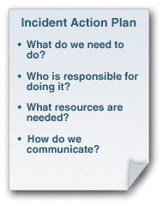
Management Characteristics
Management by Objectives relies on the Incident Commander or Unified Command establishing incident objectives that drive incident operations and include the following:
  Establishing specific, measurable incident objectives
  Identifying strategies, tactics, tasks and activities to achieve the objectives
  Developing and issuing assignments, plans, procedures, and protocols to accomplish identified tasks
  Documenting results for the incident objectives
  Incident Action Planning is a concise, coherent means of capturing and communicating overall incident priorities, objectives, strategies, tactics, and assignments in the context of both operational and support activities in an Incident Action Plan (IAP). The IAP focuses on addressing the needs of future timeframes (operational periods) and should:Cover a specified timeframe.
  Be proactive
  Specify the incident objectives
  State the activities to be completed
  Assign responsibilities
  Identify needed resources
  Specify communication protocols
For smaller/less complex incidents, the IAP may be oral or written, except for hazardous materials incidents, which require a written IAP. FEMA has developed a series of ICS Forms for use in developing a written IAP.

Slide 12
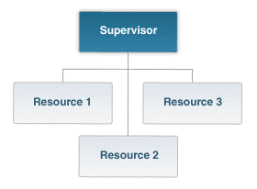

Management Characteristics
Manageable Span of control refers to the number of individuals or resources that one supervisor can manage effectively during an incident.
The optimal span of control is one supervisor to five subordinates (1:5).
A ratio of 1:5 is a guideline--incident personnel should use their best judgement to determine the appropriate ratio for an incident.
Incident Facilities and Locations depend upon the incident size and complexity. Incident Command may establish various types of support facilities including:
  Incident Command Post (ICP)
  Incident base, staging areas, and camps
  Mass casualty triage areas
  Point-of-distribution
  Emergency shelters

Slide 13
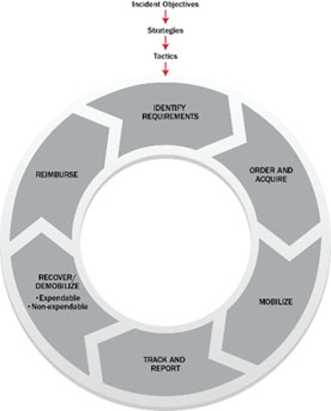
Management Characteristics
Comprehensive Resource Management describes standard mechanisms to identify requirements, order and acquire, mobilize, track and report, demobilize, and reimburse and restock resources such as personnel, teams, facilities, equipment and supplies.
Integrated Communications are facilitated through the development and use of a common communications plan and interoperable communication processes and systems that include voice and data links necessary to:
  Maintain connectivity
  Achieve situational awareness
  Facilitate information sharing

Slide 14
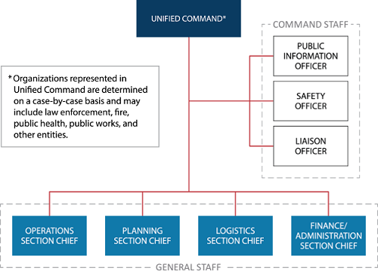
Management Characteristics
Establishment and Transfer of Command should be clear at the beginning of an incident. The jurisdiction or organization with primary responsibility for the incident designates the Incident Commander and the process for transferring command.
Transfer of command may occur during the course of an incident. When command is transferred, the process should include a briefing that captures all essential information for continuing safe and effective operations.
In a Unified Command there is no single "Commander," instead the Unified Command manages the incident through jointly approved objectives. Unified Command allows agencies with different legal, geographic, and functional responsibilities to work together effectively without affecting individual agency authority, responsibility, or accountability.
Unified Command is typically established when no single jurisdiction, agency or organization has the authority and/or resources to manage the incident on its own.

Slide 15
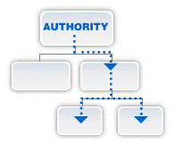
Management Characteristics
Chain of Command is an orderly line that details how authority flows through the hierarchy of the incident management organization. Chain of command:
  Allows an Incident Commander to direct and control the actions of all personnel on the incident.
  Avoids confusion by requiring that orders flow from supervisors
Unity of Command deals with the fact that all individuals have a single designated supervisor they report to and based on this principle, you will:
  Report to only one Incident Command System (ICS) supervisor
  Receive work assignments only from your ICS supervisor
When you are assigned to an incident, you no longer report directly to your day-to-day supervisor.

Slide 16
Management Characteristics
Accountability during incident operations is essential. As part of the Incident Command System (ICS) structure, you will need to abide by agency policies and guidelines and any applicable local, tribal, state, or Federal rules and regulations and adhere to the following principles:
  Check-In/Check-Out. All responders must report in to receive an assignment. Checking out is just as critical as checking in
  Incident Action Planning. Response operations must be coordinated as outlined in the Incident Action Plan
  Unity of Command. Each individual will be assigned to only one supervisor
  Personal Responsibility. ICS relies on each individual taking personal accountability for his or her own actions
  Span of Control. Supervisors must be able to adequately supervise and control their subordinates, as well as communicate with and manage all resources under their supervision
  Resource Tracking. Supervisors must record and report resource status changes as they occur. Accountability starts as soon as a resource is requested through the time that the resource returns to their home base safely

Slide 17
Management Characteristics
Dispatch/Deployment. Resources should be deployed only when requested or when dispatched by an appropriate authority through established resource management systems.
Resources not requested should refrain from self-dispatching to avoid overburdening the incident command.
Information and intelligence Management. Incident management must establish a process for gathering, analyzing, assessing, sharing, and managing incident-related information and intelligence. In NIMS, "intelligence" refers exclusively to threat-related information developed by law enforcement, medical surveillance, and other investigative organizations.

Slide 18
Unit 3: Overview
This unit introduces you to the Incident Command System (ICS) Functional Areas and roles of the Incident Commander and Command Staff. Topics covered will include:
  Five major functional areas
  Command Staff role
  The Incident Commander
  Selection of and transfer of command between Incident Commanders
  Position titles associated with the Command Staff
  Roles of the Command Staff
  Differences between incident command and incident coordination

Slide 19
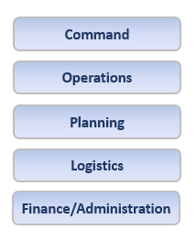
Five Major ICS Functional Areas
These five major ICS functional areas apply to incidents of all sizes and types, including both planned events and ones that occur without warning.
Its important for you to know what these terms mean. For instance, you may be directed to provide documents to the Planning Section or receipts to the Finance/Administration Section.
Incident Command: Sets the incident objectives, strategies, and priorities, and has overall responsibility for the incident.
Operations: Conducts operations to reach the incident objectives. Establishes tactics and directs all operational resources.
Planning: Supports the incident action planning process by tracking resources, collecting/analyzing information, and maintaining documentation.
Logistics: Arranges for resources and needed services to support achievement of the incident objectives (resources can include personnel, equipment, teams, supplies, and facilities).
Finance/Administration: Monitors costs related to the incident. Provides accounting, procurement, time recording, and cost analyses.

Slide 20
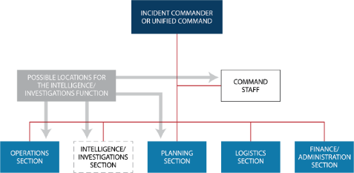
Intelligence/Investigations Function in ICS

Slide 21
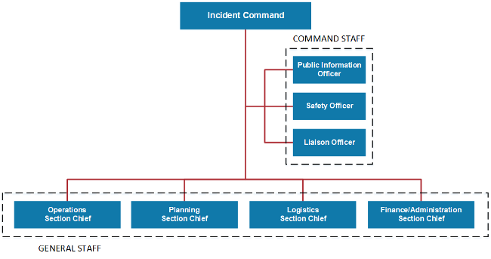
ICS Structure

Slide 22
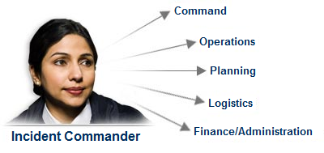
Incident Command Definition
NIMS defines command as the act of directing, ordering, or controlling by virtue of explicit statutory, regulatory, or delegated authority.
When using ICS to manage an incident, an Incident Commander is assigned. The Incident Commander has the authority to establish objectives, make assignments, and order resources. The Incident Commander works closely with staff and technical experts to analyze the situation and consider alternative strategies.
The Incident Commander should have the training, experience, and expertise to serve in this capacity. Qualifications to serve as an Incident Commander should not be based solely on rank, grade, or technical knowledge.

Slide 23
Incident Commander Responsibilities
The Incident Commander is responsible for the overall management of the incident. Overall management includes Command Staff assignments required to support the incident command function. The Incident Commander is the only position that is always staffed in ICS applications. On small incidents and events, one person -the Incident Commander-may accomplish all management functions.
The Incident Commander is specifically responsible for:
  Ensuring overall incident safety
  Providing information services to internal and external stakeholders, such as disaster survivors, agency executives, and senior officials
  Establishing and maintaining liaisons with other agencies participating in the incident
The Incident Commander may appoint one or more Deputies. If a Deputy is assigned, he or she should be fully qualified to assume the Incident Commanders position.

Slide 24
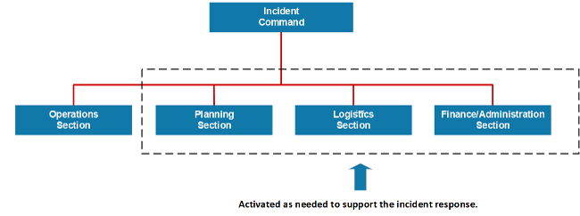
Establish, Change, Delegate Command
The command function should be clearly established at the beginning of an incident. The jurisdiction or organization with primary responsibility for an incident designates the individual at the scene who is responsible for establishing command and the protocol for transferring command. As an incident becomes more or less complex, command may change to meet the needs of the incident.
When command is transferred, the process should include a briefing that captures all essential information for continuing safe and effective operations.
When delegating incident management responsibilities, the Incident Commander only creates those sections that are needed. If a section is not staffed, the Incident Commander will manage those functions.

Slide 25
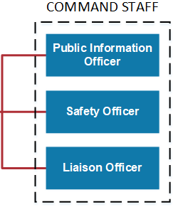
ICS Command Staff
Depending upon the size and type of incident or event, the Incident Commander may designate personnel to provide information, safety, and liaison services. In the Incident Command System (ICS), the Command Staff may include:
  Public Information Officer, who interfaces with the public and media and/or with other agencies with incident-related information requirements
  Safety Officer, who monitors incident operations and advises the Incident Commander on all matters relating to safety, including the health and safety of incident management personnel
  Liaison Officer, who serves as the Incident Commanders point of contact for representatives of governmental agencies, non-governmental organizations (NGOs), and private-sector organizations
Incident Commanders may also choose to appoint technical specialists (such as legal, medical, science and technology, or access and functional needs) to act as command advisors.
The Command Staff reports directly to the Incident Commander. In a complex incident, Assistant Officers may be assigned to each of the Command Staff functions.

Slide 26
Command Staff Overview - Video

Slide 27
Incident Command & Coordination
Effective incident management consists of four overarching areas of responsibility:
  Direct tactical response to save lives, stabilize the incident, and protect property and the environment
  Incident support through resource acquisition, information gathering, and interagency coordination
  Policy guidance and senior level decision making
  Outreach and communication with the media and public to keep them informed about the incident
These objectives are accomplished using the Incident Command System (ICS), Emergency Operations Centers (EOCs), Multi-agency Coordination (MAC) Groups, and the Joint Information System (JIS), respectively.
Incident Coordination involves the activities that ensure the onsite Incident Command System (ICS) organization receives the information, resources, and support needed to achieve those incident objectives. Examples of coordination activities include:
  Establishing policy based on interactions with agency executives, other agencies, and stakeholders
  Collecting, analyzing, and disseminating information to support the establishment of shared situational awareness
  Establishing priorities among incidents and resolving critical resource issues
  Facilitating logistics support and resource tracking
  Synchronizing public information messages to ensure that everyone is speaking with one voice

Slide 28
EOC & JIC Roles
Jurisdictions and organizations across the Nation use Emergency Operations Centers (EOCs) as an element of their emergency management programs. Typically, an EOC supports the on-scene response by relieving the Incident Commander of the burden of external coordination and the responsibility for securing additional resources. An EOC is:
  A physical or virtual location where staff from multiple agencies come together to address imminent threats and hazards
  Staffed with personnel trained for, and authorized to, represent their agency/discipline
  Equipped with mechanisms for communicating with the incident site
  Providing support to the incident by obtaining resources
  Applicable at different levels of government
Another coordination entity is the Joint Information Center (JIC). The JIC:
  May be established to coordinate all incident-related public information activities
  Serves as the central point of contact for all news media-when possible, public information officials from all participating agencies should co-locate at the JIC
JICs may be established at various levels of government and at incident sites. Depending on your role in the incident, you may need to direct individuals or organizations to the JIC to obtain information.

Slide 29
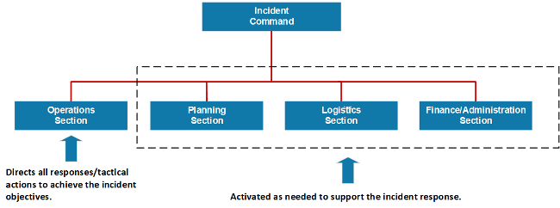
Unit 4: General Staff
To maintain span of control, the Incident Commander may establish any or all of the following four sections: Operations, Planning, Logistics, and Finance/Administration.
In an expanding incident, the Incident Commander first establishes the Operations Section. The remaining sections are established as needed to support the operation.

Slide 30
General Staff Overview Video

Slide 31
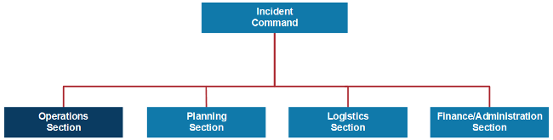
Operations Section
The Incident Commander determines whether there is a need for an Operations Section. If no Operations Section is established, the Incident Commander will perform all operations functions, otherwise they will designate an Operations Section Chief.
The Operations Section Chief activates any additional staffing needed. When the Operations Section Chief is designated, the staging and management of operational resources moves from the Incident Command to Operations.
The major activities of the Operations Section may include:
  Implementing strategies and developing tactics to carry out the incident objectives
  Directing the management of all tactical activities on behalf of the Incident Commander
  Supporting the development of the Incident Action Plan to ensure it accurately reflects current operations
  Organizing, assigning, and supervising the tactical response resources

Slide 32
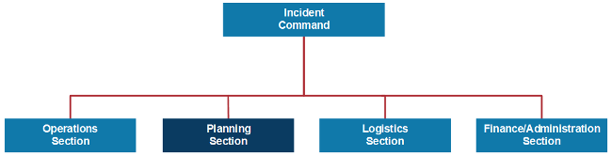
Planning Section
The Planning Section Chief is designated only after the Incident Commander determines there is a need for a Planning Section.
It is up to the Planning Section Chief to activate any additional staffing needed.
The Incident Commander will perform all planning functions if no Planning Section is established.
The major activities of the Planning Section may include:
  Preparing and documenting Incident Action Plans
  Managing information and maintaining situational awareness for the incident
  Tracking resources assigned to the incident
  Maintaining incident documentation
  Developing plans for demobilization

Slide 33
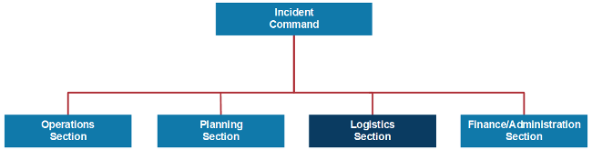
Logistics Section
The Logistics Section Chief is designated only after the Incident Commander determines whether there is a need for a Logistics Section.
It is up to the Logistics Section Chief to activate any additional staffing that is needed.
The Incident Commander will perform all logistics functions if no Logistics Section is established.
The Logistics Section is responsible for all services and support needs, including:
  Ordering, obtaining, maintaining, and accounting for essential personnel, equipment, and supplies
  Providing communication planning and resources
  Setting up food services for responders
  Setting up and maintaining incident facilities
  Providing support transportation
  Providing medical services to incident personnel

Slide 34
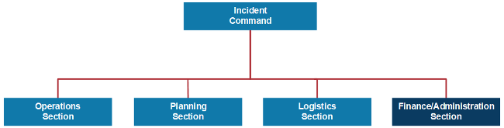
Finance/Admin Section
The Incident Commander determines whether there is a need for a Finance/Administration Section at the incident. If so, the Incident Commander will designate an individual to fill the position of the Finance/Administration Section Chief.
The Time, Compensation/Claims, Cost, and Procurement Units may be established within this section.
The Finance/Administration Section is set up for any incident that requires incident-specific financial management. The Finance/Administration Section is responsible for:
  Contract negotiation and monitoring
  Timekeeping
  Cost analysis
  Compensation for injury or damage to property
  Documentation for reimbursement (e.g., under mutual aid agreements and assistance agreements)

Slide 35
Course Summary
This has been a fast and furious overview of the IS-100c course “Introduction to the Incident Command System (ICS).”
After studying the course in-depth and on-line, you should be able to:
  Explain the principles and basic structure of the Incident Command System (ICS).
  Describe the NIMS Management Characteristics that are the foundation of ICS.
  Describe the ICS functional areas and the roles of the Incident Commander and Command Staff.
  Describe the General Staff roles within ICS.
  Identify how NIMS management characteristics apply to ICS for a variety of roles and discipline areas.

Slide 36
IS-100.c Final Exam Instructions
  When taking the test online
    Go to http://training.fema.gov/IS/crslist.asp and click on the link for IS-0100.c.
    Click on "Take Final Exam."
    Read each item carefully.
    Check your work before submitting your answers.
To receive a certificate of completion, you must take the multiple-choice Final Exam and score at least 75 percent on the test.
Upon successful completion of the Final Exam, you will receive an e-mail message with a link to your electronic certification.

