Slide 1
Anderson Powerpoles
Standard for ARES/RACES!

Slide 2
Anderson Powerpoles
The Anderson Powerpole has been adopted by the amateur radio community as their standard 12-volt DC power connector for everything from radios to accessories.
Powerpole connectors are physically and electrically hermaphroditic, thus avoiding the need to worry about which end is the plug and which the socket, or which end has the correct polarity.

Slide 3
Anderson Powerpoles
Standard for ARES/RACES!
For use in amateur radio, the community has adopted a standard polarity for assembling the Singlepole connectors, using one red and one black housing, as well as a mnemonic for remembering the arrangement for the positive connector: Red Right—Tongue Top.
The ham standard is "12 volts" (actually 13.8 volts), with red positive and black negative.

Slide 4
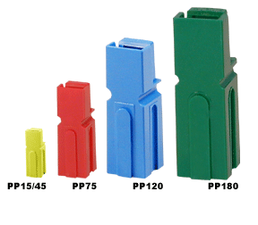
Powerpole Identification
4 different sizes
PP15/30/45
PP75
PP120
PP180
Only PP15/30/45 are interchangeable. All others are not!

Slide 5
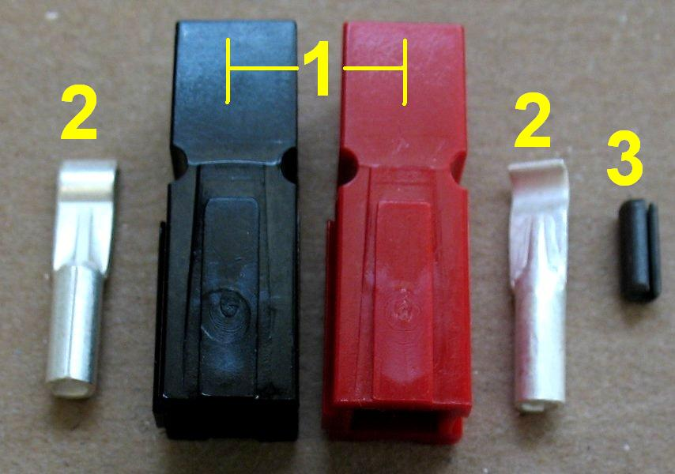
Powerpole parts breakdown
Housing
Contacts
Lock pin (I recommend not using. Use glue instead)

Slide 6
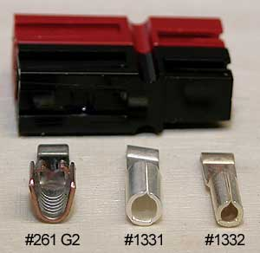
PP 15/30/45 Differences
15/30- Only difference is the size of the wire barrel on contact
45-Style of wire mount is different than the 15/30
When connected, hard to distinguish other than wire gauge used.

Slide 7
One housing design, three contact options
P/N | Max Amp | Gauge
CONTACT OPTIONS
1332 | 15A | 16-20
1331 | 30A | 12-16
261G2 | 45A | 10-14
CONNECTOR HOUSING
1327 | RED
1327G6 | BLACK

Slide 8
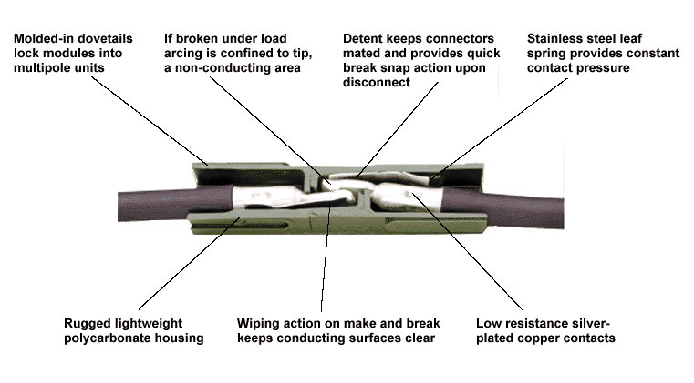
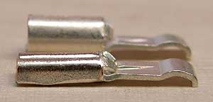
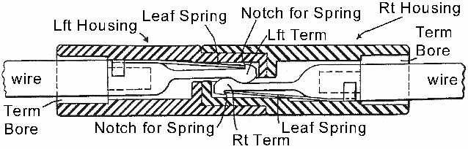
Anatomy of a Powerpole

Slide 9
Powerpole assembly tools
Three basic tools needed
    Wire cutters
    Wire strippers
    Contact crimper*
One sundry item
    Glue/adhesive (aka crazy glue)

Slide 10
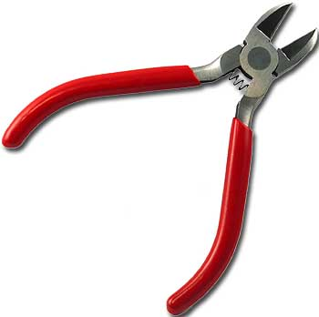
Wire cutters
Nothing fancy.
Good and sharp
Appropriate to gauge of wire your using.

Slide 11
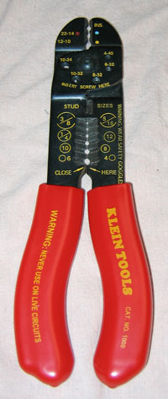
Wire Strippers
Good and sharp
Appropriate to gauge of wire your using.

Slide 12
Contact crimper
Heart of the procedure!
Mess this up and you’ve botched the whole thing (contact wont lock in or worse…WIRE CAN COME OUT)!
Three different styles.
    Not Recommended
    If you have money to burn.
    Just Right!

Slide 13
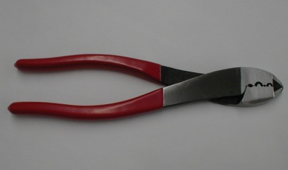
Contact crimpers (NO!)
Guaranteed to mess up
Inconsistent results
Inexpensive…$12.99
Overall rating, “0”

Slide 14
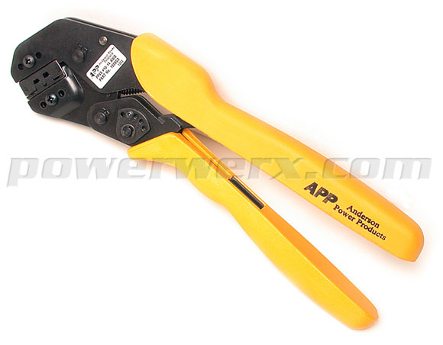
Contact crimpers (Top of the Line)
Consistent results!
Official APP crimper
Only does 30 and 45A contacts
$219.99!
Anderson Power Pole Crimpers

Slide 15
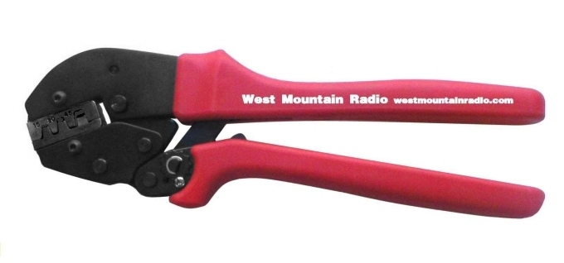
Contact crimpers (Just right!)
West Mountain Radio crimper
Consistent results
Does 15, 30 and 45A contacts!
$39.95!

Slide 16
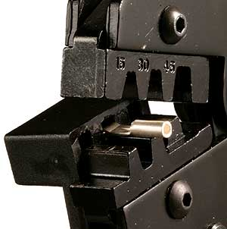
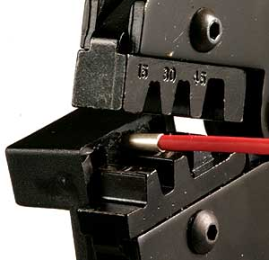
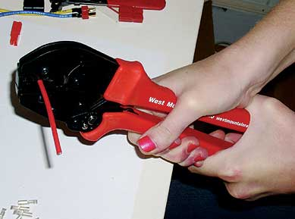
Powerpole Connector Assembly Procedure
1
2
3
The “best” crimping tool for the money is the West Mountain PWRcrimp (Currently $39.95).

Slide 17
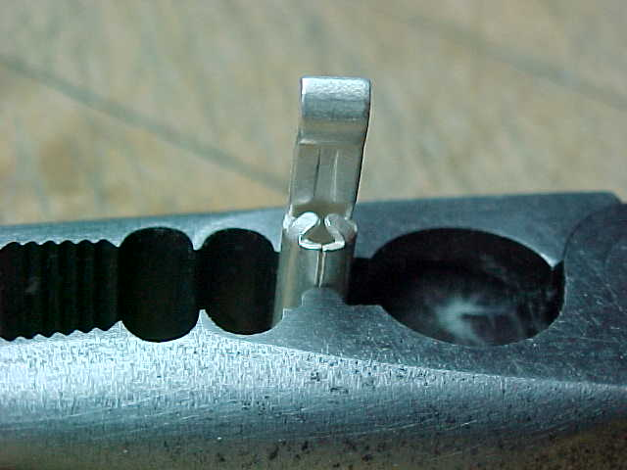
Incorrect Crimping Technique
NO
Regardless of the crimping tool used, the seam in the barrel of the contact must be against the rounded side of the tool’s die.

Slide 18
Assembly procedures

Slide 19
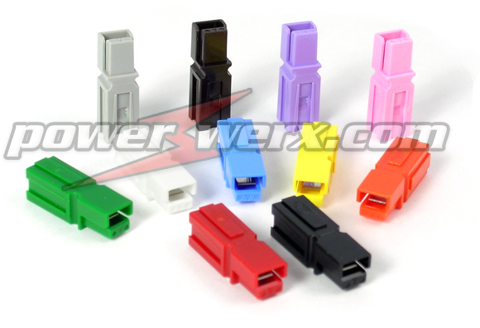
Shell selection
They come in 11 different colors
Red Black (What we use in Amateur Radio)
Blue Green
White Orange
Yellow Grey
Brown Violet
PINK!

Slide 20
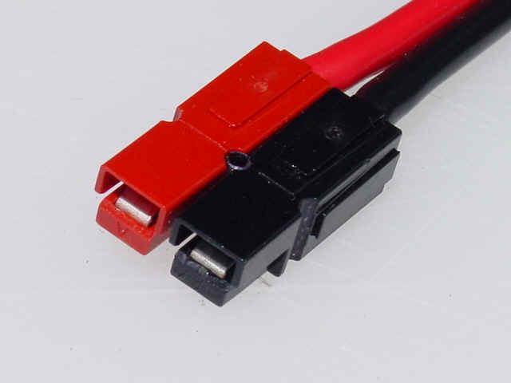
Shell selection
(AMATEUR RADIO)
RED +12vdc
BLACK Return
Yes , there is an standard color code. ARES/RACES uses red/black to indicate +12vdc.

Slide 21
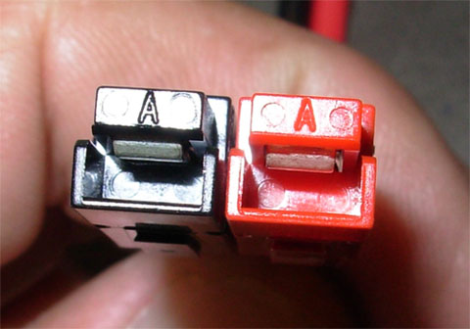
Shell assembly
Shell orientation VERY important.
As you are looking at the connector.
Tongues up
“A”s up
Black on left
Red on right

Slide 22
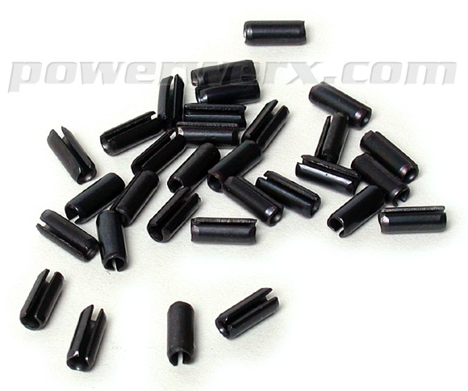
Shell assembly
Locking pins...
THROW THEM AWAY OR RECYCLE!
Chances of pin coming out under vibration very good
Steel and electricity not good partners.
Just glue it!

Slide 23
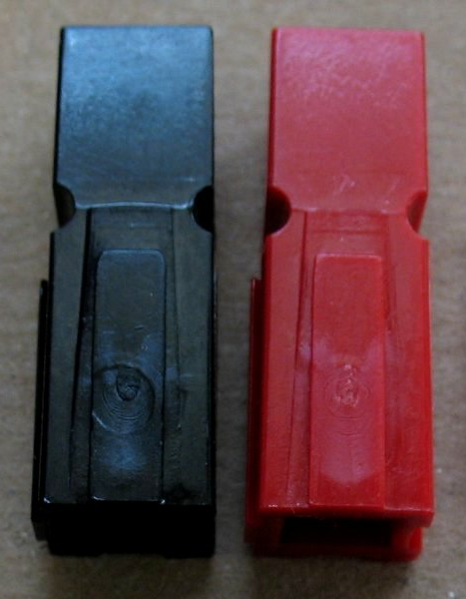
Shell assembly
Get correct orientation.
ONE DROP of glue (don’t need much) on the inside dovetail
QUICKLY and with a little force, slide them together till they are both level
DONE!

Slide 24
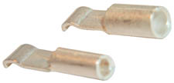
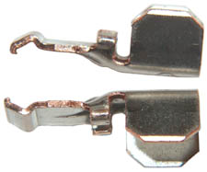
Contactor Selection
15/30/45 What is the wire size?
15 20~16ga
30 16~12ga
45 14~10ga

Slide 25
Contactor assembly.
Square off the wire ends
Split conductors back about ½ inch.
Strip conductors back approximately 5/16 inch.
If stranded, twist the bundle tight
NO NEED TO TIN!
Insert conductor into contactor. Should be flush and wire should barely be seen on front of contactor.
Verify that there isn't an excess amount of conductor exposed at end of contactor. It should be almost if not flush with insulation

Slide 26
Contactor assembly continued.
Insert contactor “curve” down into crimper.
Give one or two clicks to hold contactor
Re-insert wire if necessary
FIRMLY SQUEEZE handle all the way thru the cycle and release.
Conductor done!
One note: The 45A contactor. You may need to squeeze the wire crimp wings just a bit to get it to a “U” shape to fit the crimper.

Slide 27
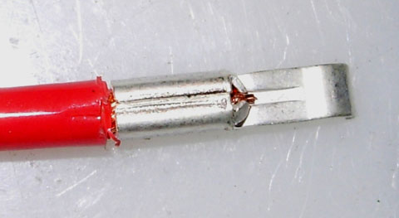
Should look just like this!

Slide 28
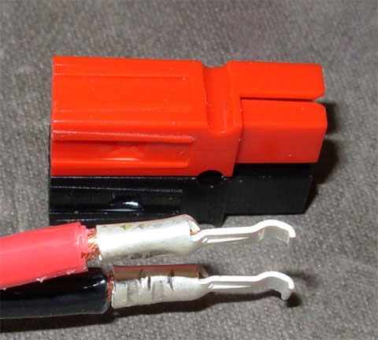
These are acceptable too!

Slide 29
P.S. This is also the correct orientation for insertion into a correctly coded powerpole shell!

Slide 30
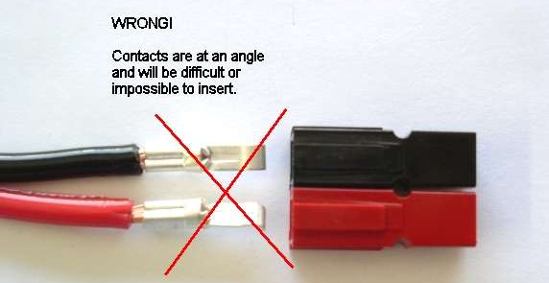
INCORRECT examples
Contacts at odd angle.
Twist them gently to correct orientation.

Slide 31
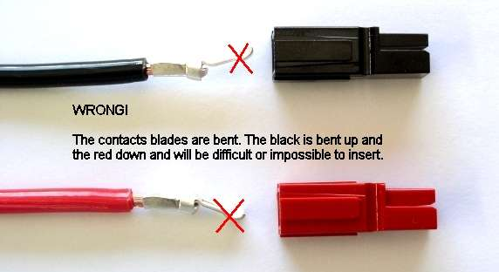
INCORRECT examples
Contact blades bent.
Gently straighten them up.

Slide 32
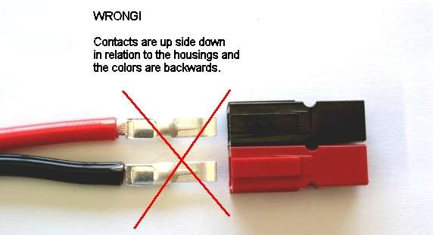
INCORRECT examples
WRONG ORIENTATION!
Flip wire and gently twist conductors to match connector.

Slide 33
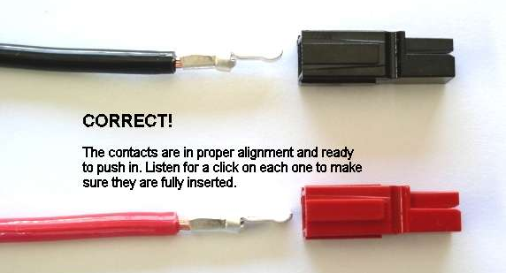
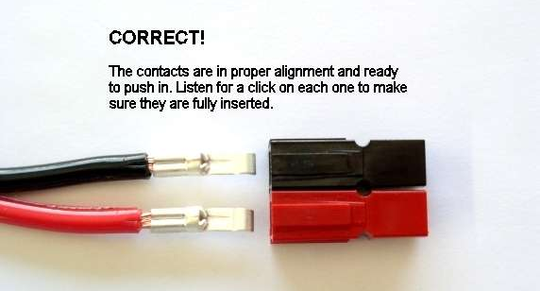
CORRECT examples
Contacts straight
Contacts correctly aligned
Contacts correctly polarized
Ready to insert

Slide 34
Final connector assembly
Insert contactor “curve” down towards the tongue (A).
Slide straight in until “CLICK” is heard or felt.
Tug back on conductor to verify lock
Repeat with other conductor.
DONE! One powerpole completed!

Slide 35
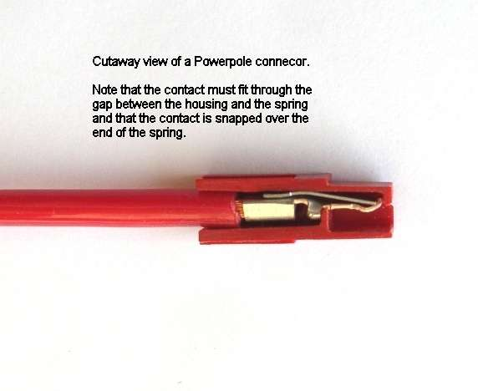
Cutaway showing contactor locked into connector

Slide 36
OOPS! I goofed up, or I need to remove the wire/conductor. What do I do?

Slide 37
OOPS! I goofed up, or I need to remove the wire/conductor.
What do I do?
Contactor removal
A special APP tool is available to help remove the contactor from the shell.
BUT, A jewelers flat blade tweaker is also probably available in your tool box that will do the same thing!
Procedure is to put the blade just under the contactor curve and lift up while pulling on the conductor. When the curve is clear, the conductor will pull right out.
(Kinda clunky first time you do it but it does work!)

Slide 38
Contactor removal
Pull on this!
Lift this up!

Slide 39
Thoughts
The 30A Powerpole is an ideal connector for 12vDC power connections.
The housings mate together through molded dovetails.
Buy twice as many contacts as you will need for your project – crimping takes some skill.
Make lots of short jumper cables to other connector types (e.g. ring, spade, OEM T-type). They’re perfect for your emergency “jump-kit”.
Keep your housings, contacts, zip wire, and crimping tool in your jump kit. This way, you can make field repairs or even construct new cables on the spot.

Slide 40
FAQ’s
“I’m using 15A connectors and the wire is just too small. What do I do?”
  Easy, double it then crimp it!
“The wire fits better in the 30A or the 45A connector but the widget is only drawing 10 amps. Can I use the higher capacity contactor?”
  You sure can! Nothing says you can’t use a higher amp contactor. Just don’t go lower!

Slide 41
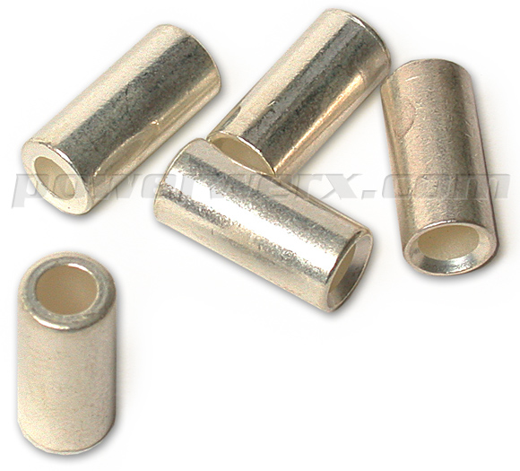
“I’m not going to double the wire. That’s just not how I roll. Any other options?”
There sure is…
Reducing bushings!

Slide 42
FAQ’s
“I don’t crimp anything. Rosin runs in my blood and I keep a strand of 60/40 in my pocket at all times! Can I solder these puppies?”
  Yes you can, but don’t bubble-gum it or use a piece of rebar to solder the thing. And don’t flow too much up the wire to harden it. Less is more and beware of not melting the insulation!

Slide 43
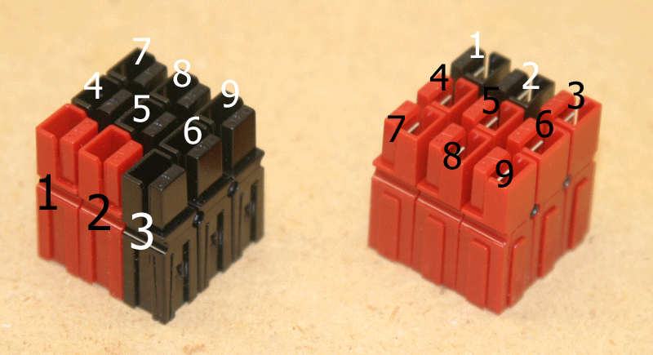
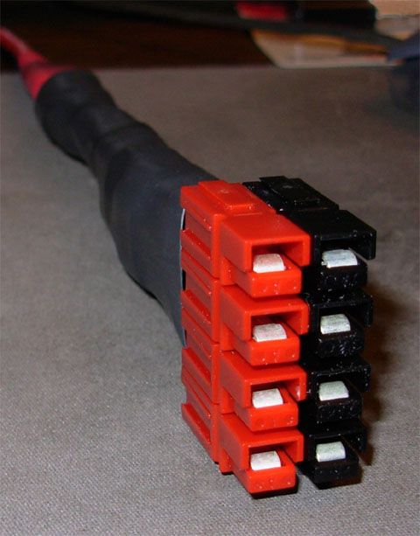
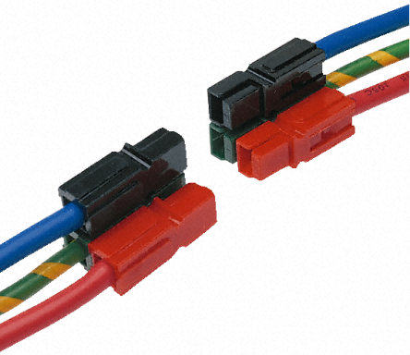
“I’m a non-standard type-o-guy and none of my installations are standard…can these things make a non-standard configuration?”
Yes they can! Use your imagination and document your work!

Slide 44
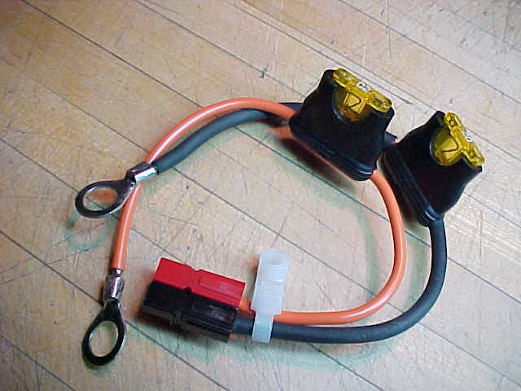
Powerpoles in Action

Slide 45
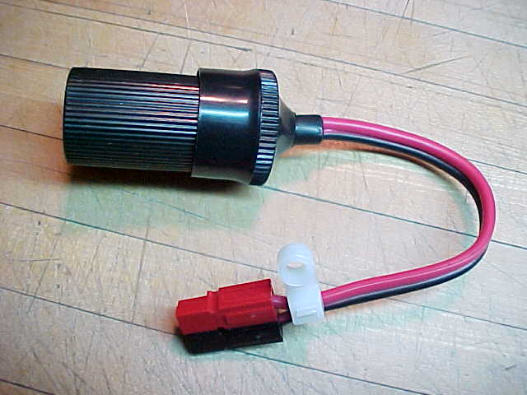
Powerpoles in Action

Slide 46
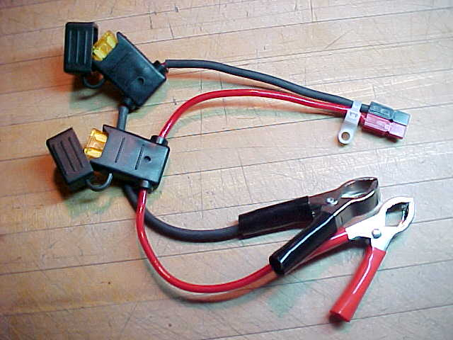
Powerpoles in Action

Slide 47
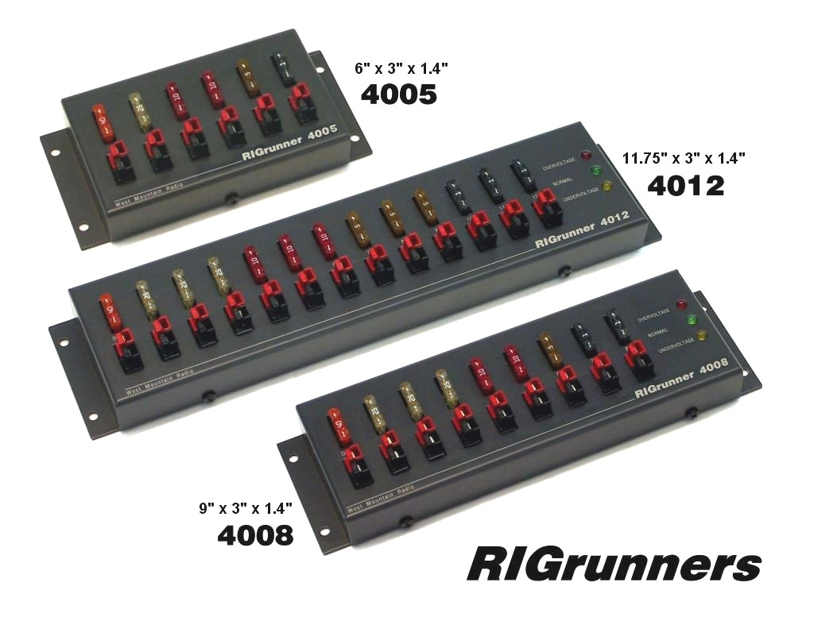
Powerpoles Accessories

Slide 48
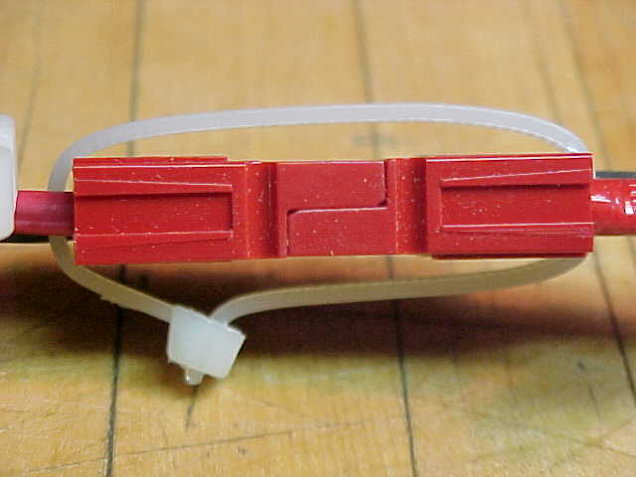
Tie Wrap Lock

Slide 49
More Information
Vendors include:
  www.powerwerx.com
  http://www.westmountainradio.com/
  http://www.dcpwr.com
  http://www.cablexperts.com (under DC Power)

