Slide 1



Slide 2
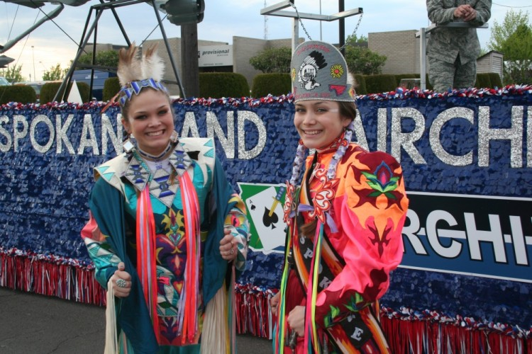
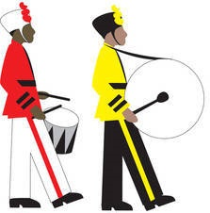
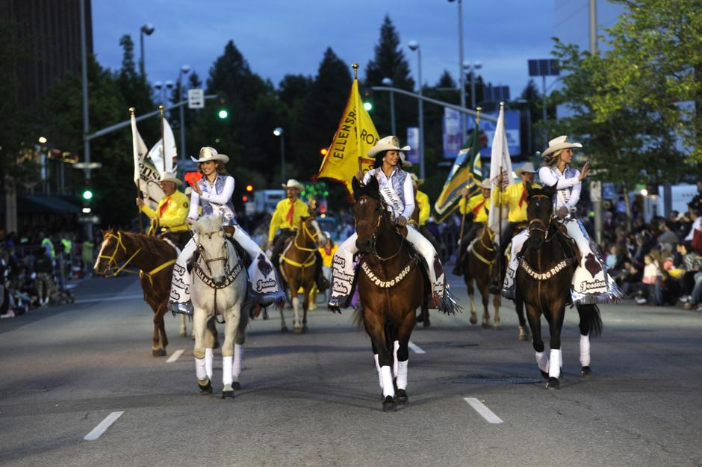

While the primary purpose of this parade is to honor our Armed Forces, it is also a showcase for our community, our schools and the culture of the Pacific Northwest.
This year, the Lilac Parade happens on
____________________

Slide 3
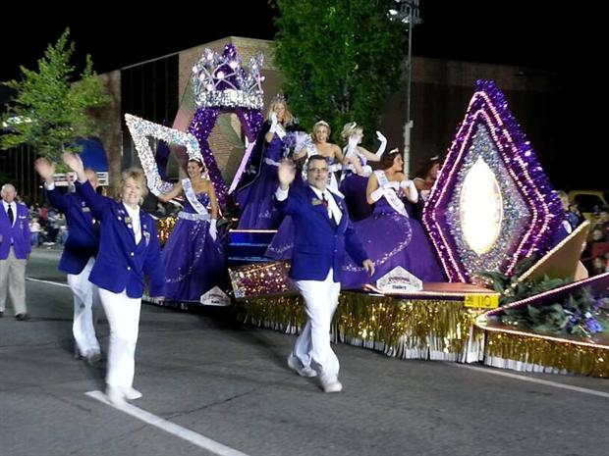
How does the Parade happen?
The Parade Krewe
The Parade Krewe
The Parade Krewe consists of a large group of volunteers who begin their yearly goal in February to coordinate and manage all of the parade intricacies.
Many of the Krewe have been volunteering for this for over 20 years, some even 30!

Slide 4
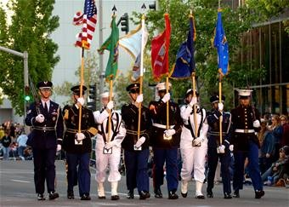
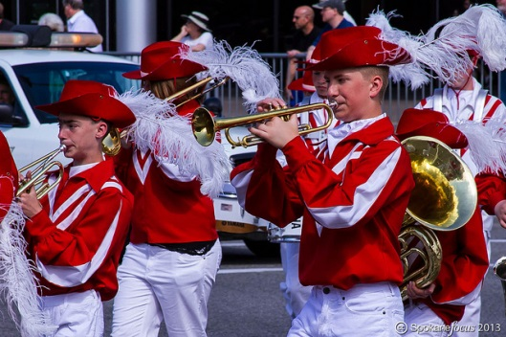
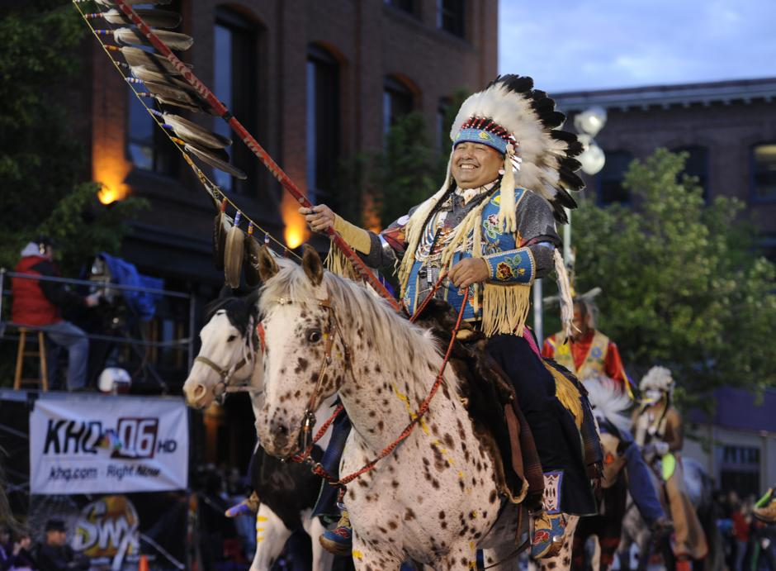
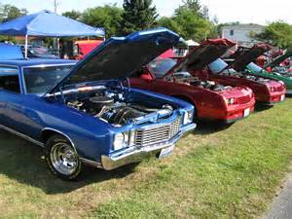
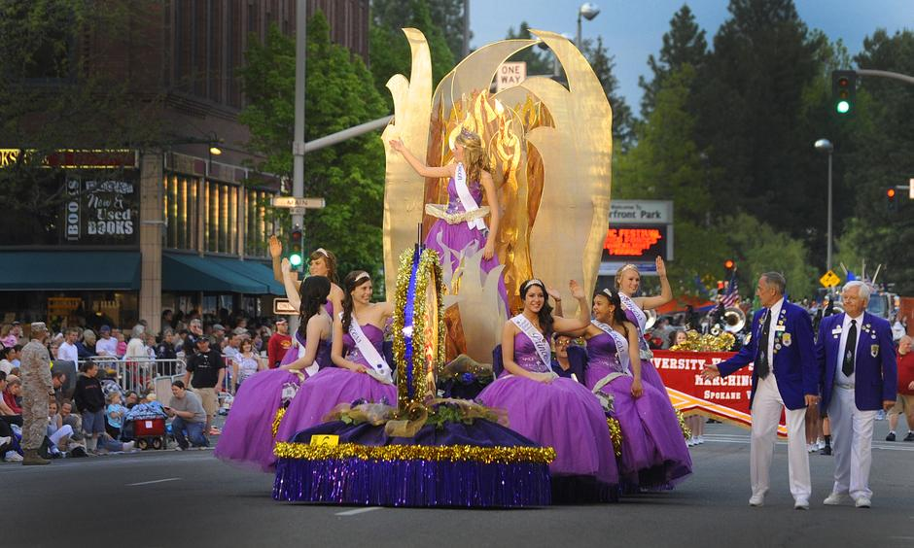
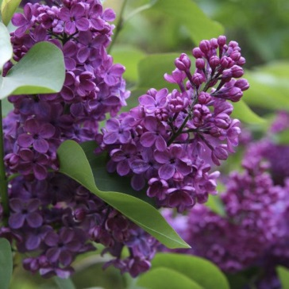
Who can be in the parade?
Dignitaries
Military dignitaries and groups
City and town floats
School Bands
School Floats
Non-Profit Organizations
Non-Political & Non-Religious
Antique and Showcase Cars

Slide 5
STAGING
The Line-Up
Both Parade Krewe and Radio Amateurs work together to get each and every unit lined up in the proper order. Numbering them too so that they are in the order as the Krewe made the lineup.
Both TV and Public Address people read off of a script for each of the units as they go through the parade. Accuracy and quick corrections are necessary to make sure the announcers have the right script to read for the right unit going by their location.

Slide 6
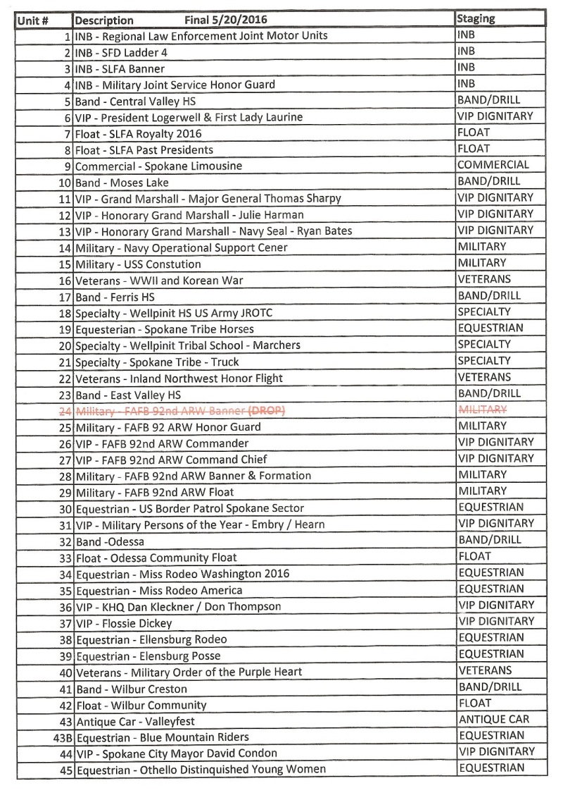
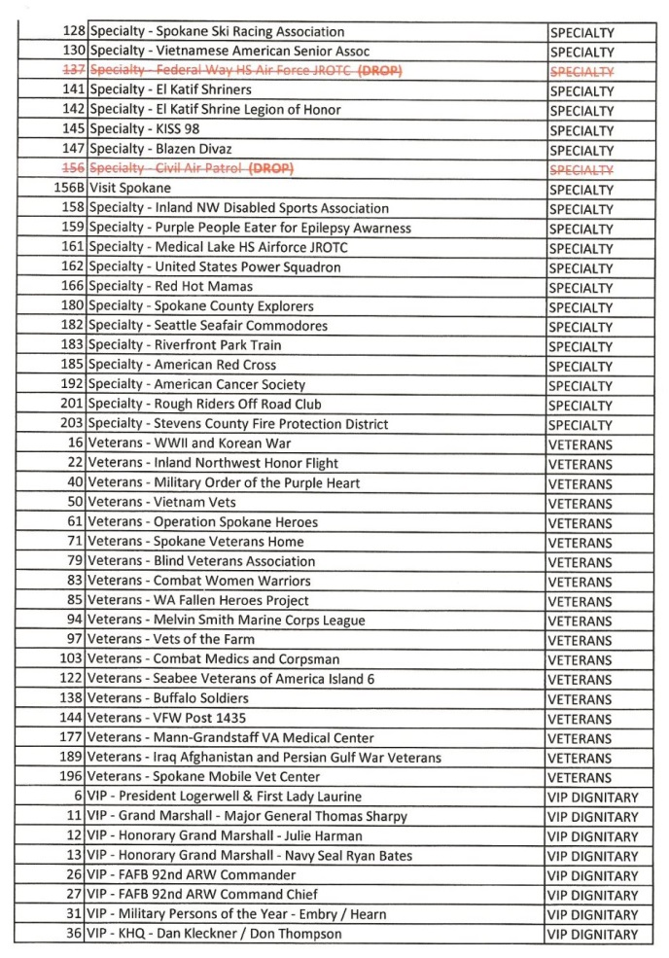
Numeric Line-Up
Line-Up by Group

Slide 7
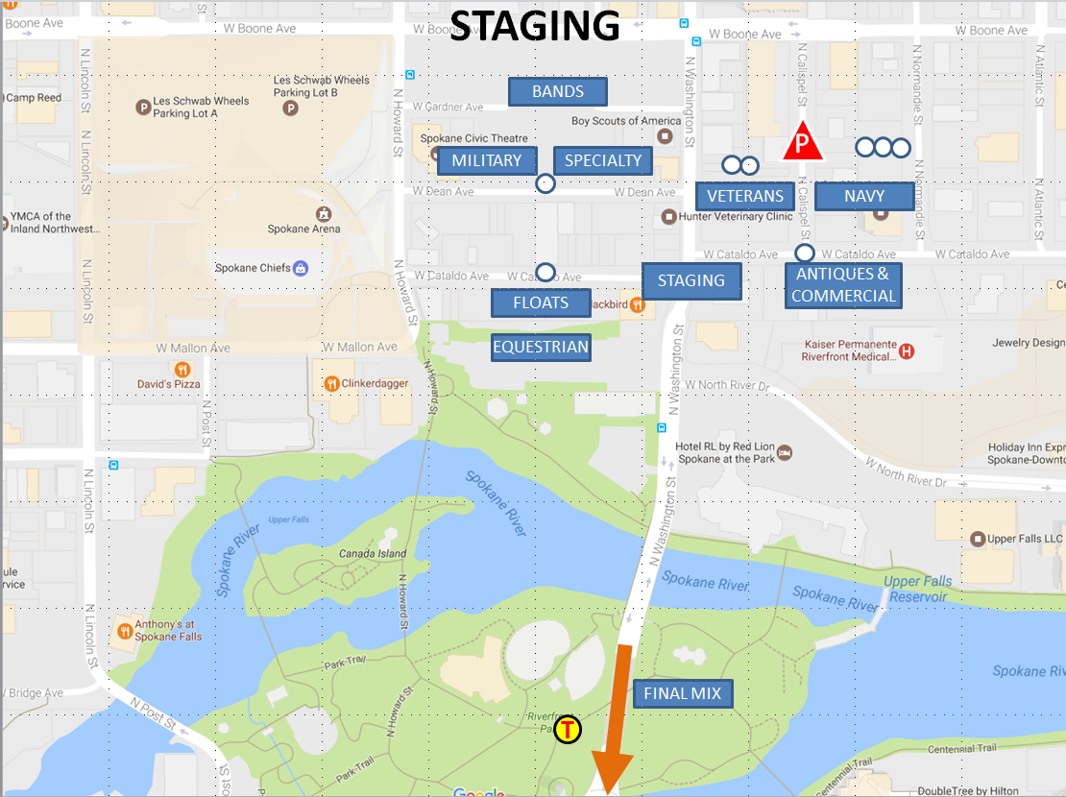
This map shows how each of the different areas feed their units toward Staging, and eventually are lined up in the proper order at Final Mix to continue through the tunnel to the Parade Start Line.

Slide 8
START LINE
The Parade Start
The beginning of the Parade. Sometimes we do get large units – those that can’t fit under the Washington Bridge – that stage or join in to their parade location at the corner of Spokane Falls Boulevard and Washington. Both Net Control and Staging are aware of units that need to stage here.
Once the units have passed the start line, they need to go through and complete the parade.

Slide 9
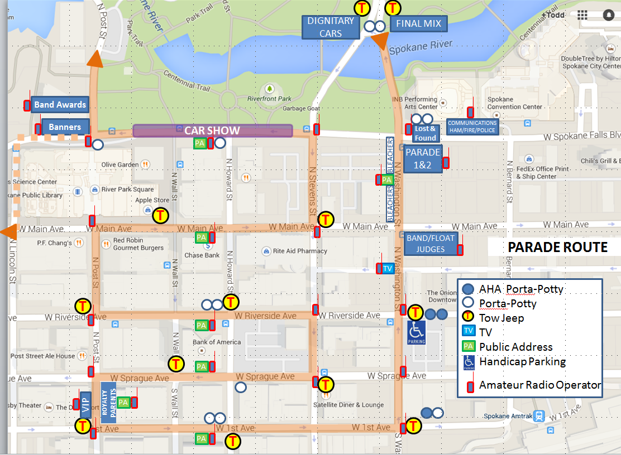
The Parade Route Map

Slide 10
GOLF CARTS
We have been given permission to use golf carts to get Amateurs quickly moved from parking locations, to the Comm Van, and then to their parade stations.
If you need a ride after the parade, coordinate through net control to reach these authorized golf cart drivers. Please do not drive a golf cart unless you have pre-approval.
___________________
___________________
___________________

Slide 11
EMERGENCIES
CComm
As Parade Radio Operators, we have direct contact with Ccomm, who in turn is seated next to dispatchers that can send Fire, Police or Ambulance to a location.
REMEMBER: Emergency Communications take priority over all other communications.
If there is an emergency going on, maintain radio silence on the frequency in use for that emergency.
Urgent issues? call the Red Phone.

Slide 12
EMERGENCIES
CComm
What CComm needs you to tell them to get help dispatched quickly:
Location of the situation (know your cross streets)
VERY BRIEF description of the situation
(Riot, Fire, Flood, Pregnancy, Injury)
If a person is involved, a HIPAA compliant description of victim – Sex, Approx. Age, Injury
NO NAMES!

Slide 13
HORSES – SHHHHH!
Equestrians
Please be quiet around the horses.
Please don’t spook or bother the horses.
Avoid walking up to Equestrian Units.
Treat as if they are Service Animals.
Please help other units to stop playing instruments, or music when horses are nearby.
The Parade Krewe tries to put all units in an order that will not upset the horses.

Slide 14
Proper ‘Netiquette’ and Conduct
Do we use VOX at any time during the parade?
YES
NO
NO

Slide 15
Proper ‘Netiquette’ and Conduct
Net Control callsign is W7GBU
No VOX – please make sure it is PTT only.
Know where your PTT is – No Open Mic please!
Proper calling procedure is, “Hey You, It’s Me” – Who you are calling, and then who you are.
Be prepared to be ‘Frequency Agile’ if asked or needed
Never give the frequencies by numbers over the air,
  only by tactical frequency name
Do not respond to malicious interference
Use your tactical call for brevity, finish with your FCC Callsign
All traffic goes through Net Control
Contact Net Control and be acknowledged before you begin to communicate your issue
Notify Net Control when you go off or come back on frequency
Always finish communications with your FCC Callsign

Slide 16
Proper ‘Netiquette’ and Conduct
For those ‘shadowing’ a Parade Official (Staging area, Final Mix, Start Line, OPS)
‘Stick like glue’ to that official but don’t crowd them
Follow their instructions, only communicate on their behalf
Always know where they are and how to reach them quickly
Always make yourself available to them
Always end communications with your FCC callsign
For those on Public Address stations: (TV, Public Address)
Stay at your position, call for relief if needed
Report any emergencies
Listen carefully as line-up changes and drops happen frequently
Be prepared to write down changes
Be prepared to repeat the change or question for clarification
Clearly communicate changes to the Announcer.
To acknowledge a line-up change or drop, simply give your FCC callsign.

Slide 17
Proper ‘Netiquette’ and Conduct
For Corner (CHARLIE) Variable (VICTOR) stations:
Stay at your position, call for relief if needed
Listen for your callsign!
Report any emergencies
Report if you have a Tow Vehicle at your location
Only report parade gaps of unusual size
Use your tactical callsign to contact Net Control
Always finish communication with your FCC Callsign
All other Stations (Bands, Band Awards, Banners, VIP, Lost and Found, Runner)
Stay at your position, call for relief if needed
Listen for your callsign!
Report any emergencies
Use your tactical callsign to contact Net Control
Always finish communication with your FCC Callsign

Slide 18
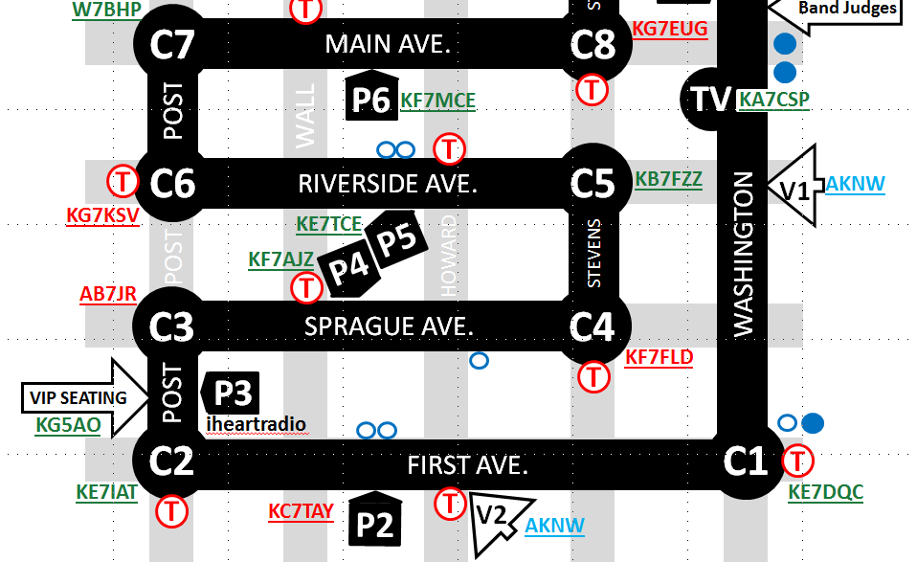
Parade Gap Mitigation
GAP!
GAP!
GAP!
GAP!
GAP!
GAP!
GAP!
The wrong way – Don’t Panic!

Slide 19
Parade Gap Mitigation
Unit #?
Gap. 2 blocks.
The Right Way – calmly communicate.

Slide 20
What to bring on Parade Day
Please be prepared for inclement weather AND nice weather
Dress accordingly and in layers
Bring your 2m radio (70cm option a bonus)
Spare batteries or spare radio
Good headphones or earbud
User manual for the radio
Water and Food
Medications if needed
Comfortable and portable chair if you’re in a stationary station
Writing utensil and or clipboard if you need to take/make notes

Slide 21
What to bring on Parade Day
We meet at the Comm Van in the usual location – in front of the INB Performing Arts Center. Meet time is 5:00 pm or 1700.
There will be packets with the tactical map, instructions, parade gap mitigation information. There will be small pieces of paper with the frequency list on them. I’ll probably say a few words during that time.
If you need a ride from your parking location to the comm van, or comm van to your station and then back to your vehicle, we have two carts operating this year. Please go through net control to request a ride.
Please be patient as we come to pick you up. Also, please be on frequency so we can coordinate pick-up.
Talk-in Frequency will be announced right now...

Slide 22
THANK YOU!
You are greatly appreciated. Every position in the Parade is useful and needed. We can always use extra radio op volunteers, and welcome them happily.
Please contact me if you have any questions, concerns or would like to volunteer for this amazing event.
73,
Todd Cady - k7pkt@arrl.net

